Slide 1
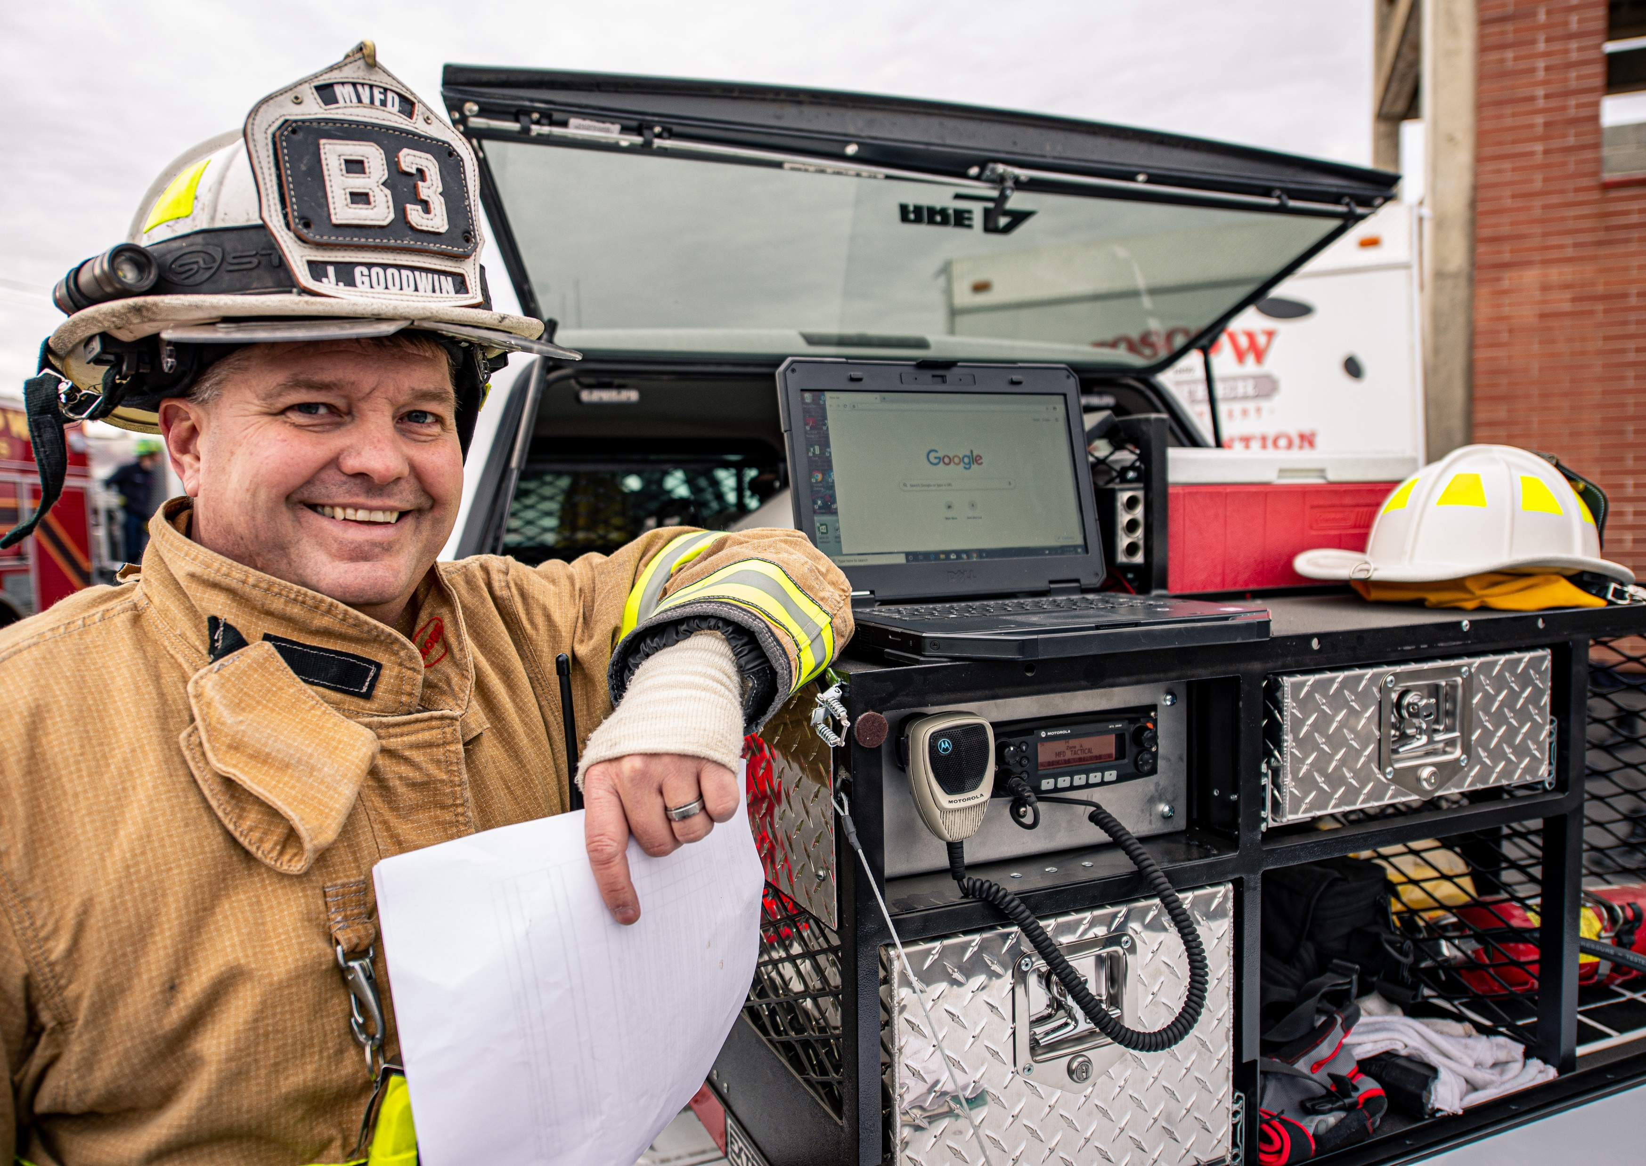
Marketing Toolkit
2024 Sponsorship Programs
NATIONAL VOLUNTEER FIRE COUNCIL
Reach
the
Volunteer
Boots on the Ground

Slide 2
NVFC’s Large Audience
NVFC
BRAND AWARENESS
AFFILIATION
SALES LEADS
30,961 Members
107,077 Followers
33,301 Web Site Visitors
(Monthly Average)
Optimize Your Marketing Initiatives
It’s about reaching the volunteer fire, EMS, and rescue community and elevating your brand and increasing sales!
NVFC is the face of the volunteer. As the leading nonprofit, it’s our mission to serve and support more than two-thirds of the total fire service in the U.S.

Slide 3
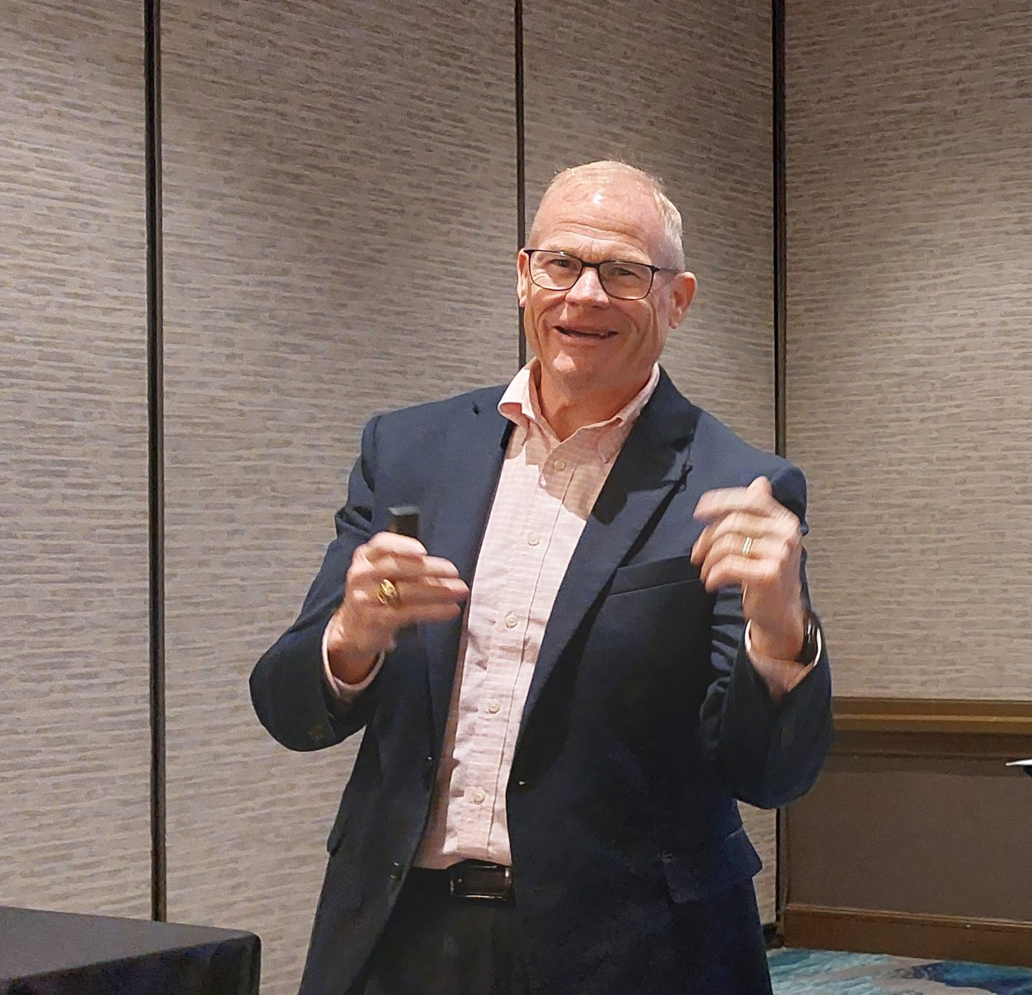
Why Partner Sponsorships are a strategic way to increase your brand recognition, build relations, and increase sales leads by partnering on high-profile activities.
NVFC
Corporate Sponsorship
KEY BUSINESS STRATEGY
NVFC has your audience. Through its valued benefits, resources, training and education, programs and advocacy, NVFC’s reach continues to grow every year.
NVFC is also unique in that its leadership is made up of representatives of 47 state fire service associations. This network provides perspective as well as a network of experts with extension into the volunteer boots on the ground – in their state and nationally.
We’re committed to offer you a valuable and effective custom package that is developed to fit your company’s goals.
NVFC has allowed us to build new connections across the country and forged many lifetime friendships. Together, we can all make a difference in the health and safety of firefighters from coast to coast. The future is bright and we look forward to our continued partnership.
David C. Denniston
Director of Risk Management

Slide 4
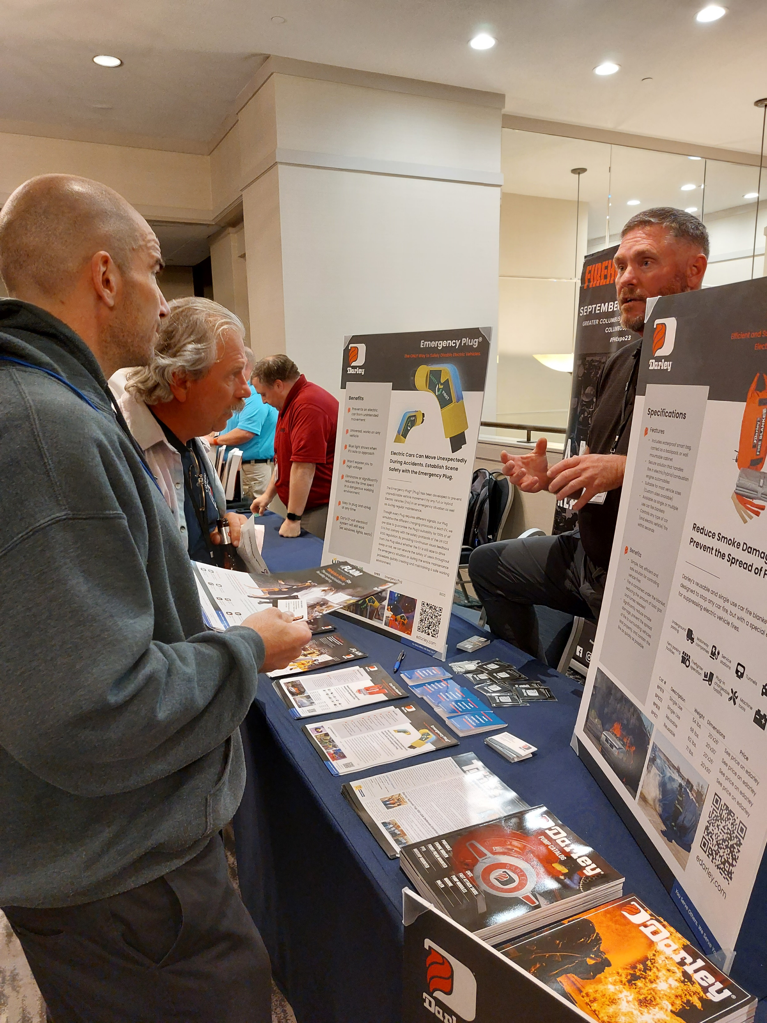
Corporate Partnerships with Impact
NVFC
Corporate Sponsorship
KEY BUSINESS STRATEGY
NVFC will listen and work with you to build a program that fits your need and budget. Whether you want a unique program, product giveaway, or individual sponsorship, you’ll get visibility and a solid team behind you.
Multi-channel marketing plan that may include announcements in newsletters, NVFC web site, social posts, & eblasts
Opportunities for direct access to conference attendees and NVFC leadership
Opportunities to address meeting attendees & webinar registrants
Access to registration lists
Opportunities to be seen as an industry authority through webinars, presentations at meetings, and thought-leader articles
Opportunity to provide giveaways and member discounts
Administrative support
Opportunity to broaden your brand
* Benefits vary based on sponsor package

Slide 5
TRAINING
Building a
Prepared
Volunteer
1st Responder Workforce
SPONSORSHIP
NATIONAL VOLUNTEER FIRE COUNCIL
On-Demand Learning
Webinar Series
Live Topical Education

Slide 6
Training & Education
NVFC
Corporate Sponsorship
BUILDING A PREPARED VOLUNTEER WORKFORCE
The Virtual Classroom is NVFC’s online learning center with on-demand and self-paced courses delivered by fire and emergency service subject matter experts. Sponsored courses provide volunteer fire, EMS, and rescue forces the ability to learn and be better prepared and equipped to do their jobs and serve their communities. With the cost-savings of online learning, this is a highly sought-after training option.
Corporate sponsors receive
3-month visibility and recognition
Logo on title page as sponsor
Logo, 2-3 sentence company statement, and URL on last slide as training sponsor
Sponsor recognition in training promotion
Opportunity to provide content expert
Opt-in registration list
Full NVFC administrative support
Cost: $1,500 existing & available course
$3,500 development of a new course

Slide 7
Training & Education
NVFC
Corporate Sponsorship
BUILDING A PREPARED VOLUNTEER WORKFORCE
The Train Strong webinar series provides topical and timely information and education monthly. Sponsored webinars allow for education to be timely, diverse, and have the capacity to respond to emerging issues quickly. Webinars also allow for the flexibility to listen live or watch the recording when it’s convenient. The Train Strong webinars are free, very popular, and have very positive survey results.
Corporate sponsors receive
Webinar administered and hosted by the NVFC
Logo on title page as sponsor
Logo, 2-3 sentence company statement, and URL on last slide
Sponsor recognition in pre- and post-promotion
Opportunity to provide content expert
Opportunity to invite customer to provide context on how product/service has helped them
Opportunity to introduce speaker(s) and up to a minute company promo
Opt-in registration list
Cost: $1,800

Slide 8
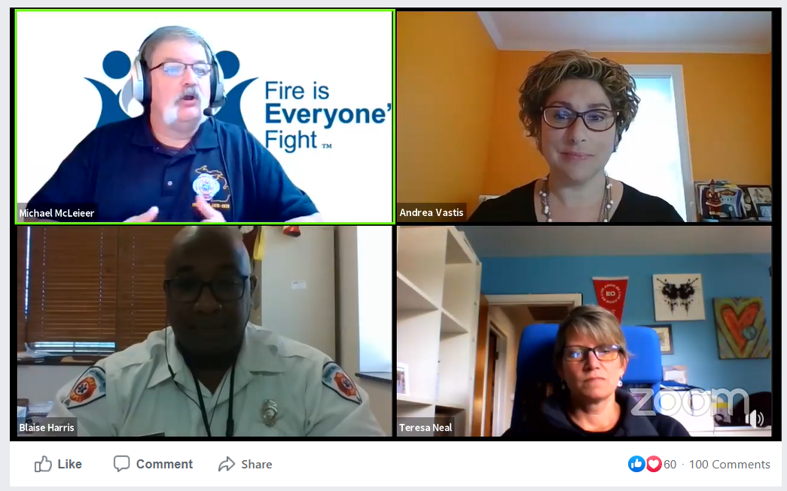
Training & Education
NVFC
Corporate Sponsorship
BUILDING A PREPARED VOLUNTEER WORKFORCE
Roundtable Talks are delivered monthly via Zoom and Facebook and provide another way to reach out to the NVFC audience with topical and timely information. Sponsored discussions allow the NVFC to react quickly and bring together the right combination of experts. By broadcasting them simultaneously on Zoom and Facebook they also enable a wider audience.
Corporate sponsors receive
Discussion administered and hosted by the NVFC
Sponsor recognition at the beginning and end of the session
Logo, 2-3 sentence company statement on promotions (Dispatch, eblasts)
Recognition in social media posts
Opportunity to provide content expert
Increased brand awareness among a wider audience
Cost: $1,500

Slide 9
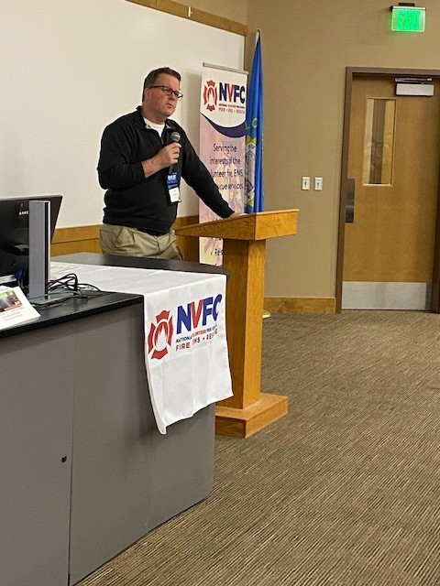
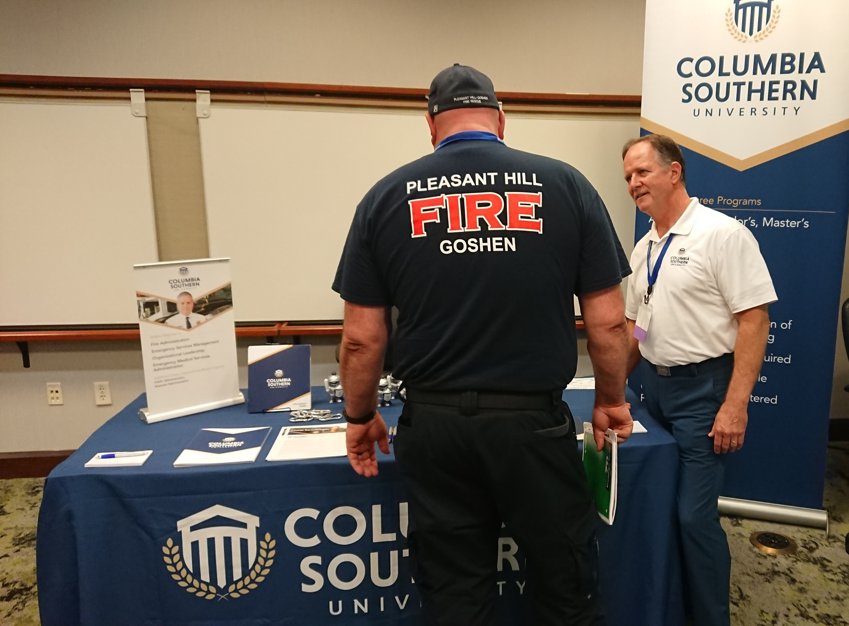
MEETINGS
Network, Build Relationships &
Get Leads
SPONSORSHIP
NATIONAL VOLUNTEER FIRE COUNCIL
NVFC Board of Directors Meetings
Training Summit

Slide 10
NVFC Board Meetings
NVFC
Corporate Sponsorship
NETWORK WITH STATE ASSOCIATION LEADERSHIP
The NVFC Spring and Fall Meetings are a gathering of 100 influential national leaders – NVFC board of directors (state fire service association representatives), corporate members, fire service partners, allied association executives and officers, and government officials. Being a part of an NVFC board meeting is a key strategy to meet with state association influencers all at one time and get the pulse of the volunteer community.
Meeting sponsors receive
Meet and network with state fire service association leadership
Logo recognition on all meeting materials
Meeting visibility with signage & podium recognition
Complimentary registration (number based on sponsor level)
Opportunity to speak
And more
Available sponsorships
Technology ($3,000) * Break ($2,000) * Speaking Opp (Breakfast $5,000 |
Lunch ($5,500) * Keynote Speaker ($5,000) * Panel ($1,500) * Registration ($2,500) *
Demo Table ($1,000) * Special Event Co-Sponsorship ($3,500)
SPRING
April 25-27, 2024
Arlington, VA
FALL
Sept. 18-20,
2024
Kansas City, MO
“Networking and building relationships is key to our success. By sponsoring NVFC Board Meetings I have direct access to state leadership while providing support to the NVFC and keeping California Casualty in front of meeting attendees.”
Roxanne Dean
AVP Group Relations and Business Development
California Casualty Management Company

Slide 11
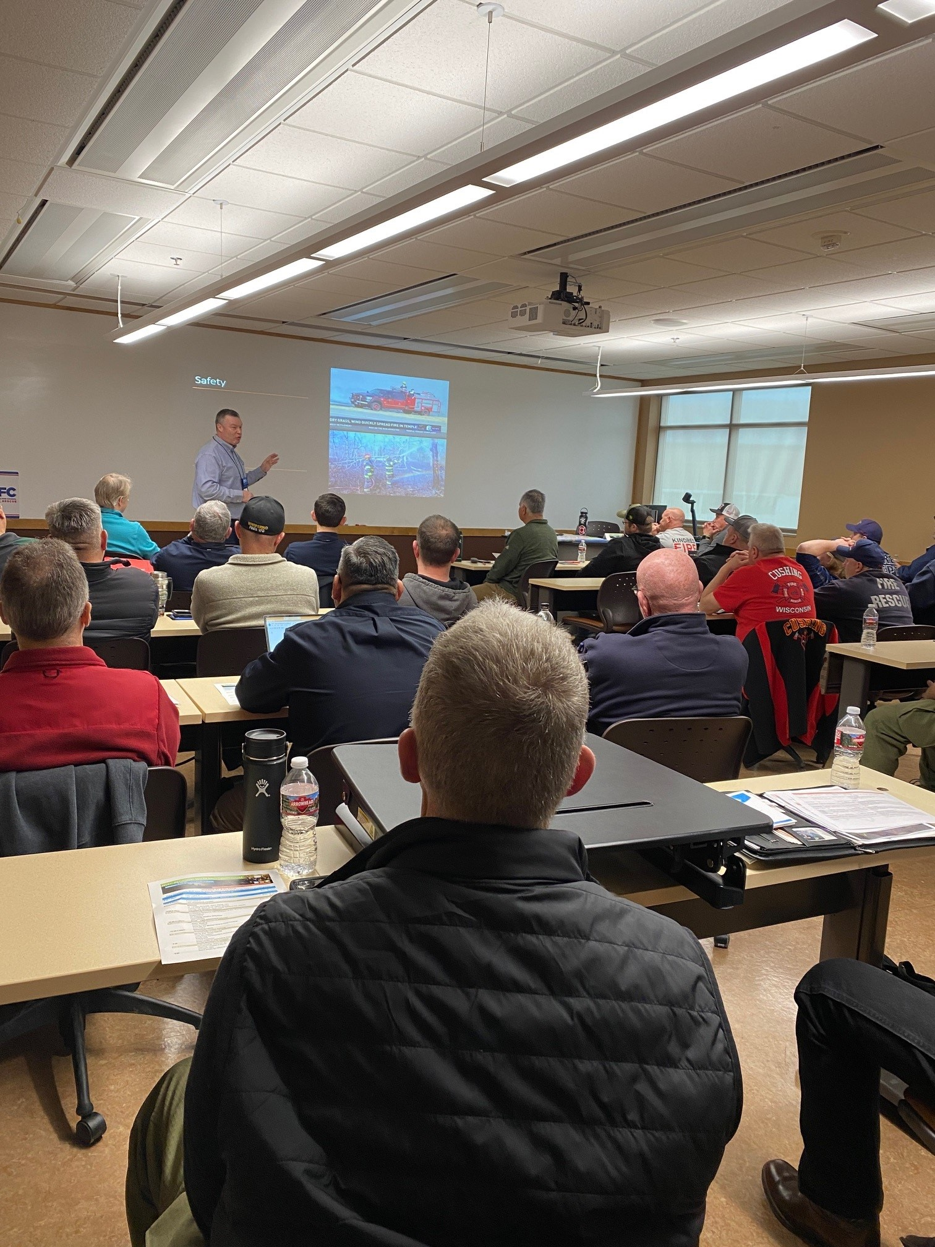
Education
NVFC
Corporate Sponsorship
DIRECT ACCESS TO
ATTENDEES
The Training Summit is a 2-day event that focuses on critical fire and emergency service topics including leadership, responder health & safety, and volunteer recruitment & retention. This is a popular event for fire chiefs, firefighters, and department leadership that come from across the U.S. Sponsors have direct access to attendees at featured social events.
Sponsors receive
Logo recognition on all meeting materials & web site
Meeting visibility with signage & podium recognition
1 Complimentary registration
Company information on resource table and in Meeting App
Speaking opportunities
Table to demonstrate, pass out material, and speak to attendees
Opt-in registration list (pre- & post-event)
Available sponsorships
Exhibits ($1,000) * Break ($2,000) * Lunch ($3,500) * Keynote Speaker ($2,500) * Registration ($1,500) * Welcome Reception ($1,500)
TRAINING SUMMIT
June 21-22,
2024
Buffalo, NY

Slide 12
ADVERTISING
Visibility & Market Outreach
NATIONAL VOLUNTEER FIRE COUNCIL
SPONSORSHIP
Dispatch e-Newsletter
The Latest e-Newsletter
Training e-Newsletter
Web Site
Firefighter Strong Newsletter

Slide 13
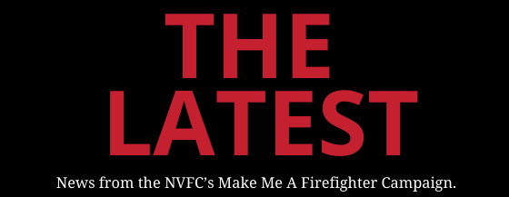
Advertising
NVFC
Advertising in e-newsletters can increase visibility, improve brand awareness, and heighten recognition for your products and services.
Corporate Sponsorship
Visibility & Market Outreach
Dispatch Newsletter is a bi-weekly e-publication providing news, information, NVFC training announcements, and links to resources. Subscribers include NVFC members. Issues are limited to 4 advertisers.
SUBSCRIBERS: 32,934
Ave. Open Rate: 31%
RATE: $400 /insert
The Latest is the bi-weekly e-newsletter providing articles and information on recruitment and retention topics. Subscriber database includes department personnel who have signed up on the Make Me A Firefighter ™ portal. Ad space limited to 1 advertiser per issue.
SUBSCRIBERS: 13,741
Ave. Open Rate: 33%
RATE: $300/insert

Slide 14
Advertising
NVFC
Advertising on the NVFC web site and The Training e-newsletter can increase visibility, improve brand awareness, and heighten recognition for your products and services.
Corporate Sponsorship
VISIBILITY & MARKET OUTREACH
WEB SITE
Advertising appears in the upper right corner of interior pages and run for 30 days.
12-month average: 27,483
Average unique visitors: 25,006
Average monthly views: 49,255
RATES:
1 Month | First Month $400
Additional Months $300 each
12 Months* $3,000 ($250/month)
(*must contract for 12 months to receive discounted rate)
The Training Times announces upcoming training including webinars and Roundtable Talks. It goes out weekly on Friday. Ad space limited to 1 ad per issue.
SUBSCRIBERS: 36,666
Ave. Open Rate: 33%
RATE: $400 /insert
NVFC Corporate Members receive complimentary ads based on membership level and receive 20% discount off published rates.

Slide 15
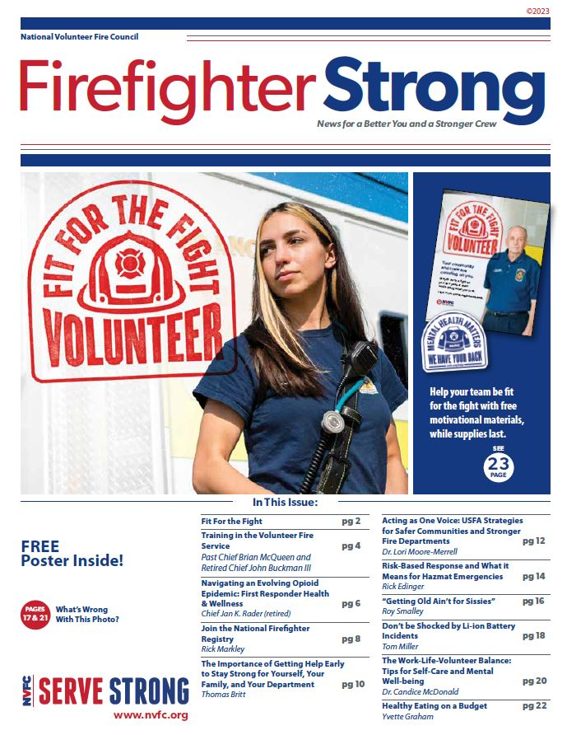
Advertising
NVFC
Advertising in the annual, topical newsletter can increase visibility, improve brand awareness, and heighten recognition for your products and services.
Corporate Sponsorship
VISIBILITY & MARKET OUTREACH
Firefighter Strong
The NVFC’s annual print publication, Firefighter Strong, is a 24-page newsletter that gets mailed to 24,000 volunteer and combination fire departments, distributed at trade shows and events, and emailed to the NVFC’s 30,000+ subscriber list. This popular publication features content relating to the health and safety of emergency responders and includes limited advertising for maximum exposure.
DISTRIBUTION: 54,500
RATES:
Full page $3,000
Half page (horizontal) $1,500
1/3 square $1,200
1/8 vertical $900

Slide 16
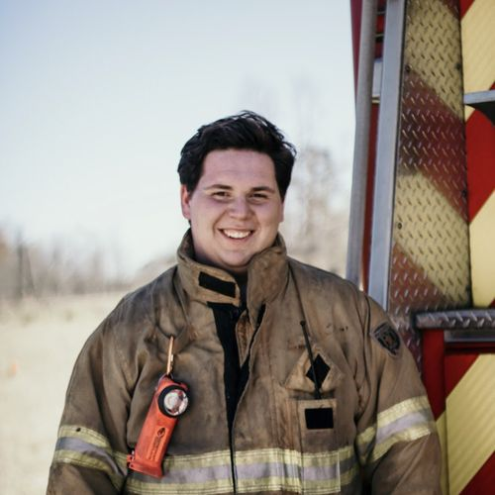
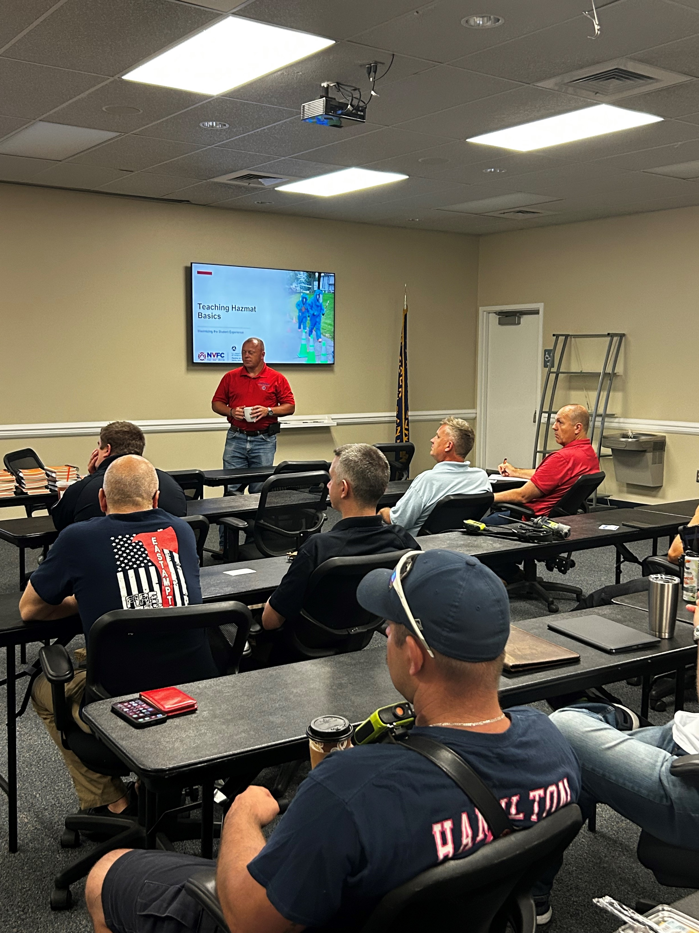
Programs & Special Opportunities
NVFC
Corporate Sponsorship
VISIBILITY & MARKET OUTREACH
When visibility and support of the volunteer boots on the ground are important to your mission, we can offer you unique ways to achieve that through:
1st Responder Helpline
Training Stipends
Resources
NVFC Annual Awards
Heather Schafer Scholarship Recipient
Resources such at the Lavender Ribbon Report
Training Stipends

Slide 17
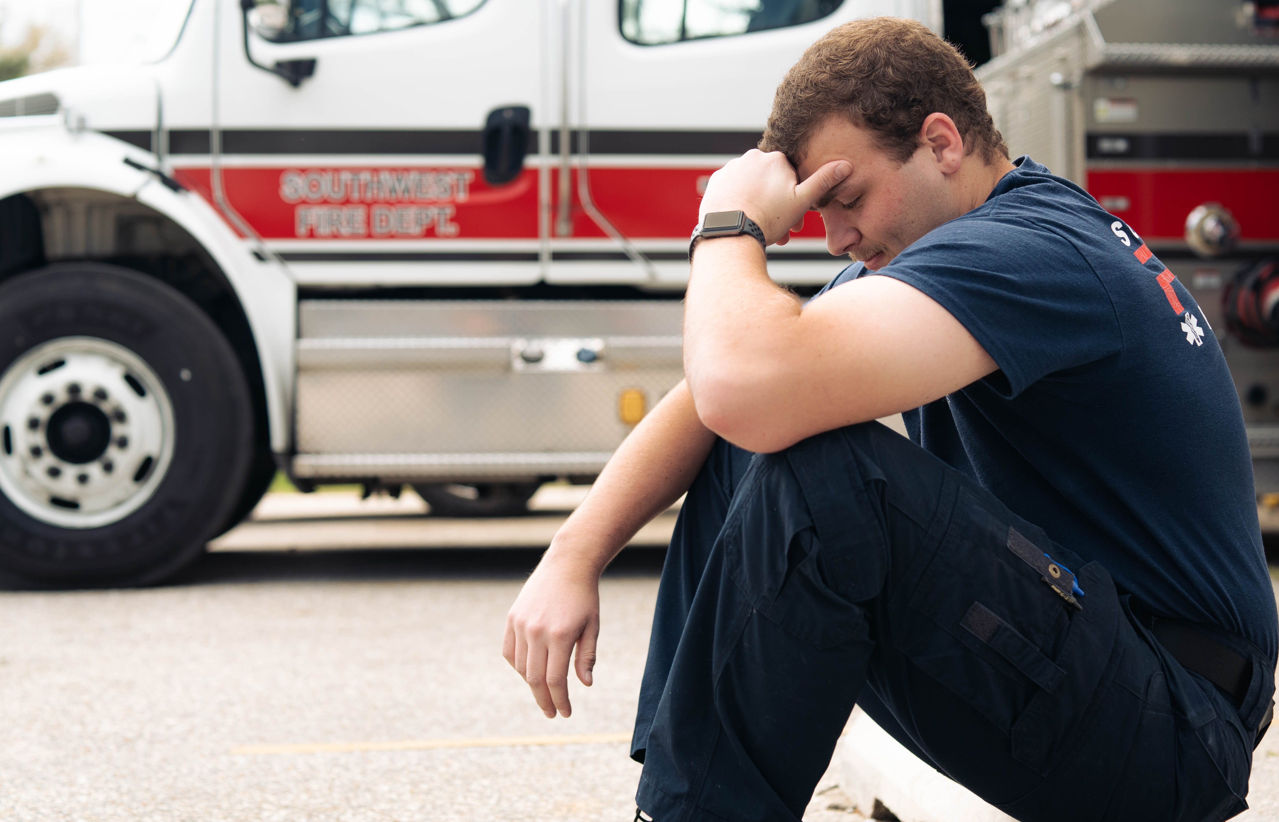
Helpline
NVFC
Sponsoring the Helpline provides unique visibility and branding. With multiple and ongoing program promotion throughout the year it significantly increases recognition for your company as well as branding to an important need of the fire service.
Corporate Sponsorship
UNIQUE VISIBILITY & MARKET OUTREACH
NVFC First Responder Helpline
Supporting the NVFC’s national helpline will get critical care to its more than 32,000 members and their families. This member benefit provides immediate access to help with up to five free confidential counseling sessions as well as consultations and resource referrals on any number of stressors – job, family, financial – as well as mental health/suicide crisis.
Your financial commitment will ensure our heroes are taken care of in their time of need.
4 Levels of Support
Partners will be recognized for a 12-month period – which includes:
Welcome/renewal letters
Ads & communications
Press releases & articles
Eblasts

Slide 18
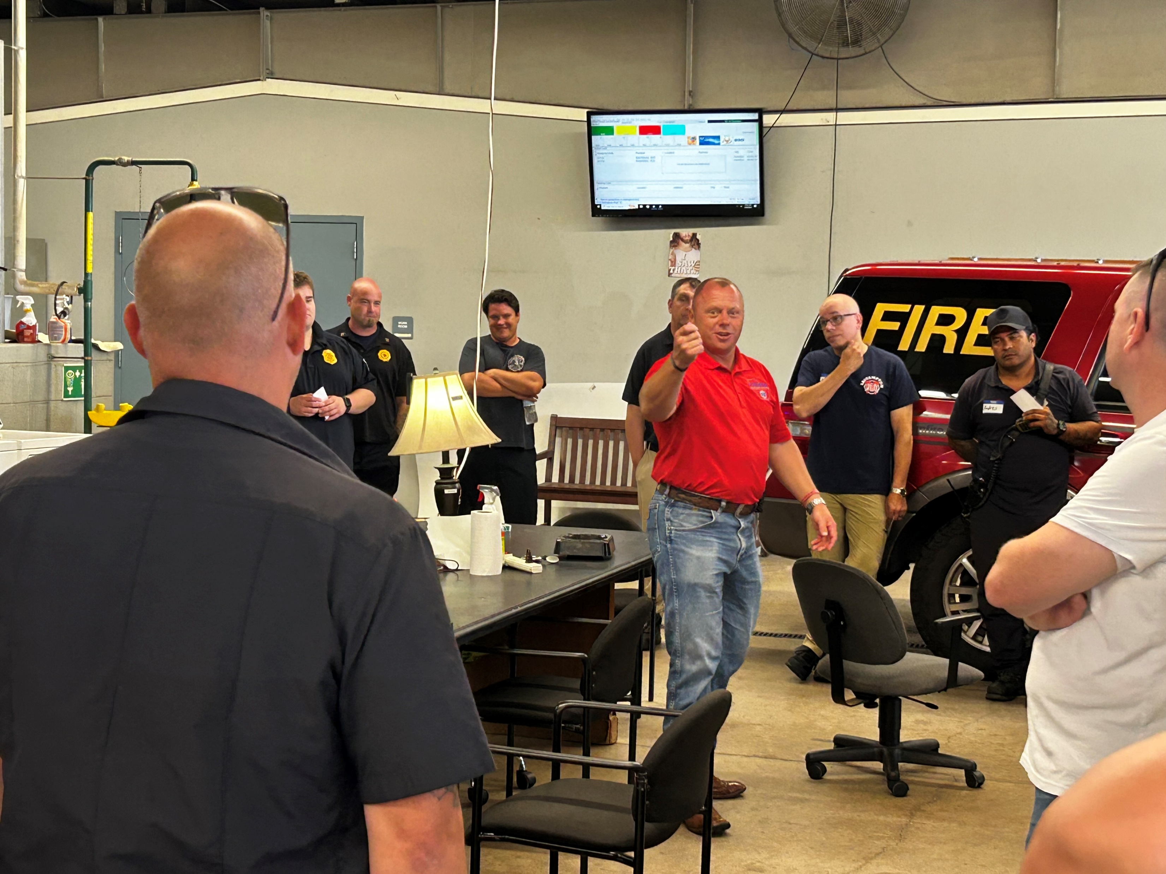
Hazmat Travel Stipends
NVFC
Sponsoring travel stipends provides unique visibility and branding. With multiple and ongoing training promotion it will increase recognition for your products and services throughout the year.
Corporate Sponsorship
VISIBILITY & MARKET OUTREACH
NVFC will be offering hazmat train-the-trainer throughout 2024 in locations all over the U.S. Attendees will be taking time away from family as well as bearing the cost to get there (training is free). To make it easier for volunteers to attend, travel stipends will be given. These will be reimbursable and up to $500 each.
Sponsorship allows for firefighters to attend needed Hazmat Training.
Cost: $500 per stipend (+admin fee)

Slide 19
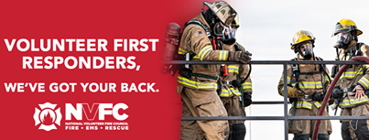
Program Resources
NVFC
Sponsoring resources will get guides, tools, and recources into the hands of fire department leadership and firefighters. It will increase recognition for your products and services throughout the year.
Corporate Sponsorship
VISIBILITY & MARKET OUTREACH
Be part of our “We’ve Got Your Back” campaign. The needs of our members and the volunteer fire, rescue, and EMS community are vast. We’re here to make sure they have the tools and resources they need. Support will go into identified resources such as:
Junior Firefighter Handbook ($5,000)
Health & Safety Packet including stickers & posters to hang in the station ($1,000 - $3,000)
Resource Guide ($5,000)
Helpline Poster ($3,000)

Slide 20
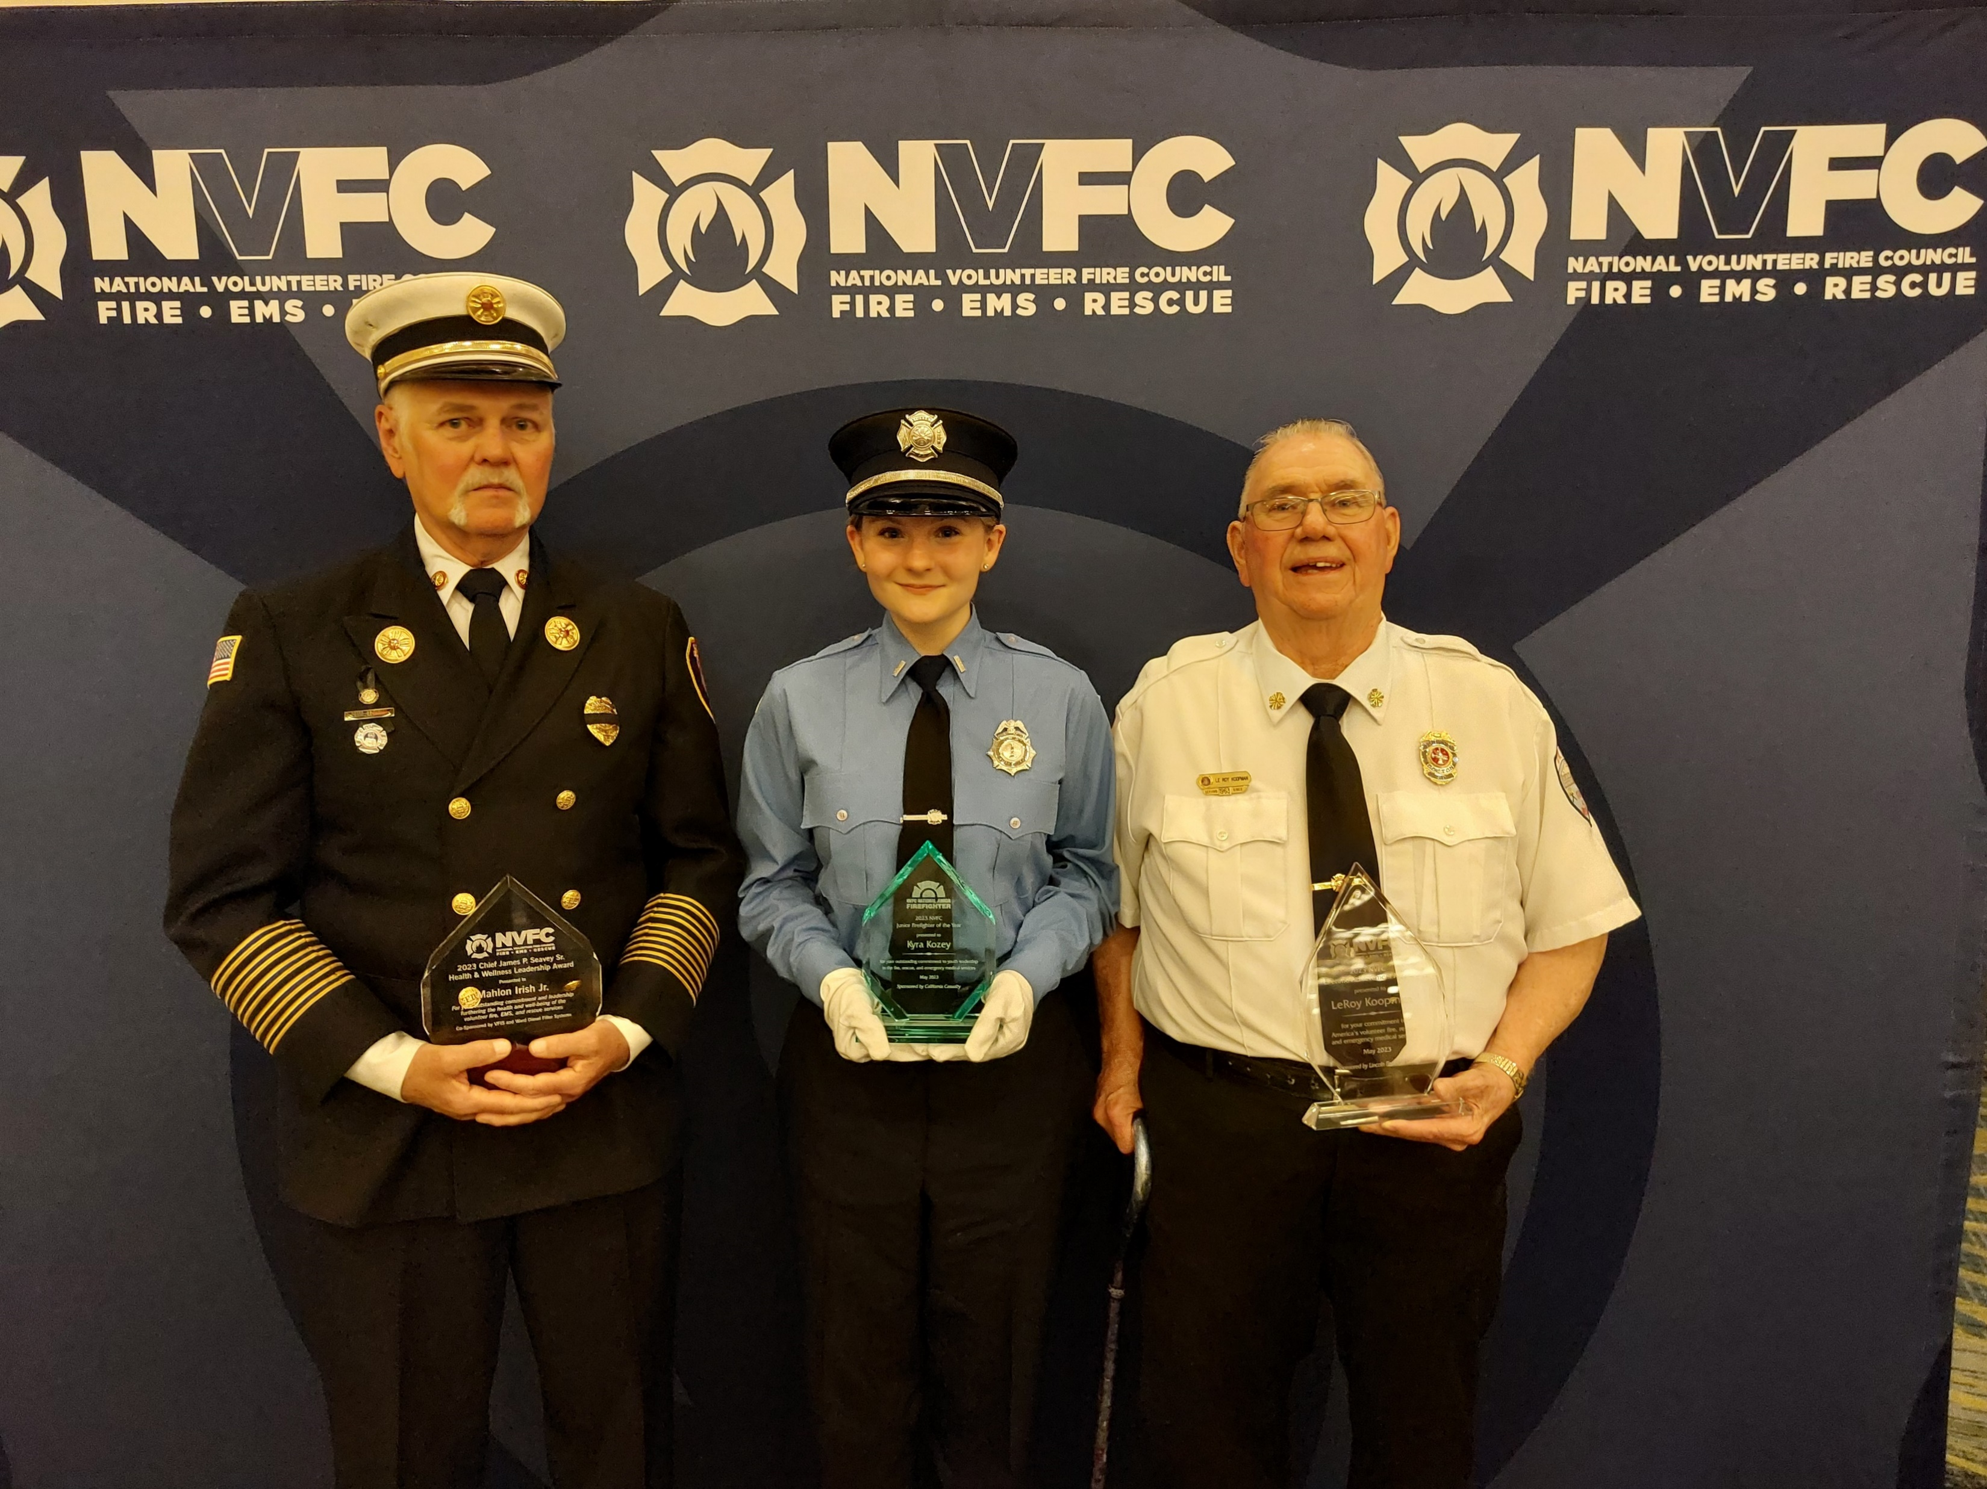
Special Initiative
NVFC
Sponsoring an NVFC award provides unique visibility. With multiple and ongoing program promotion, you’ll be affiliated with this prestigious national annual event recognizing outstanding achievement.
Corporate Sponsorship
UNIQUE VISIBILITY & MARKET OUTREACH
NVFC Awards
Each year NVFC recognizes outstanding achievement by individuals who have made a significant contribution to their department, local area, state, and/or national arena.
Sponsoring an award helps support the award process and allows the recipient and one guest to attend the award celebration held at the annual NVFC Spring Board Meeting.
Awards:
Lifetime Achievement
Chief James P. Seavey, Sr. Health & Wellness Leadership
Junior Firefighter
National Junior Firefighter Program
Cost: $7,000 each
Sponsors receive significant recognition throughout the application period, press releases and articles, presentation booklet, and name on the award along with the opportunity to co-present.

Slide 21
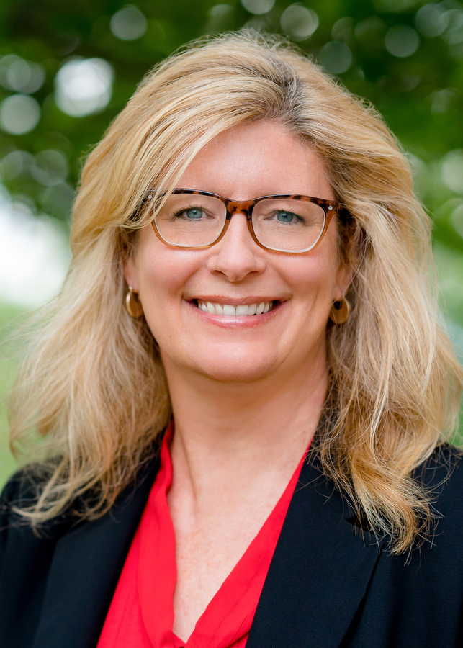
Heather Schafer Memorial Scholarship Fund
NVFC
Corporate Sponsorship
VISIBILITY & MARKET OUTREACH
Sponsoring the memorial fund provides unique visibility and branding. With multiple and ongoing program promotion it also increases recognition for your products and services throughout the year.
In memory of the legacy of long-time NVFC CEO Heather Schafer, a scholarship fund was established. This scholarship recognizes exemplary future leaders in public safety for their work to improve the delivery of the fire and emergency services in the areas of health, safety, leadership and emergency response. Qualifying individuals will be able to attend and participate in NVFC in-person training.
Sponsorship allows for scholarship recipients to attend NVFC in-person training.
Cost: $1,500 per scholarship

Slide 22
Market Outreach
INCREASE
BRAND, VOLUNTEER SUPPORT, & SALES
NATIONAL VOLUNTEER FIRE COUNCIL
Marketing Toolkit
Become a champion of the volunteer.
Now is the time to explore making NVFC a strategic business partner. Choose ala carte or have a customized packet put together.
CONTACT:
Meg Goldberg
Engagement Manager
202.887.5700 x117
meg@nvfc.org
712 H Street. NE
Suite 1478
Washington, DC 20002
202.887.5700
www.NVFC.org

