Slide 1
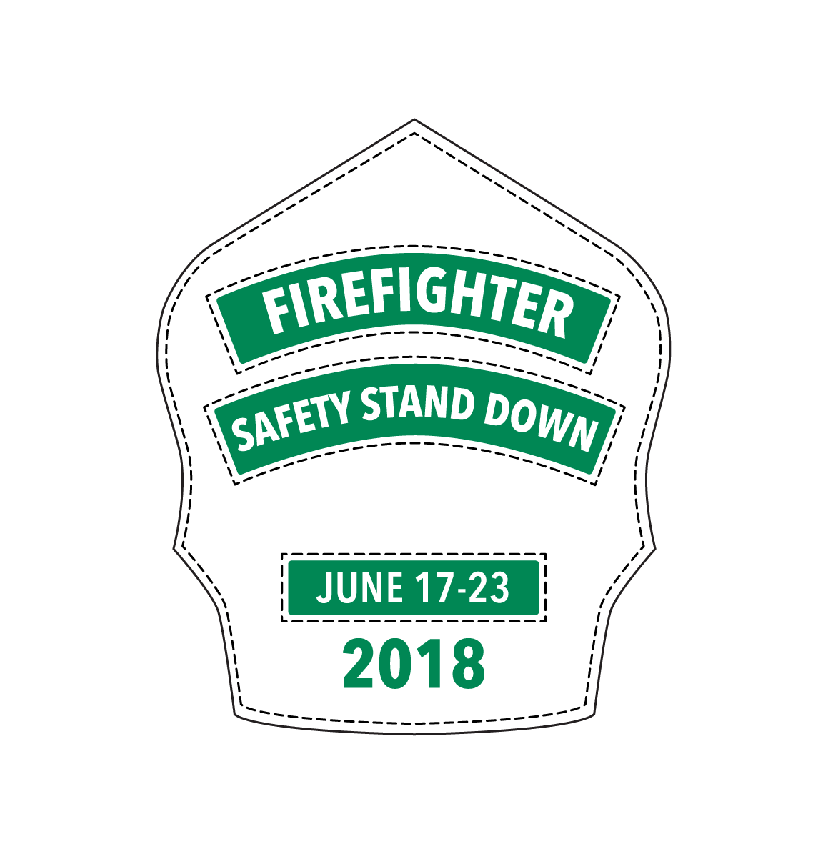
BE AWARE – GET CHECKED: Emergency Services Road Map to Health and Wellness

Slide 2
BEFORE YOU START! Be sure to enable content…

Slide 3
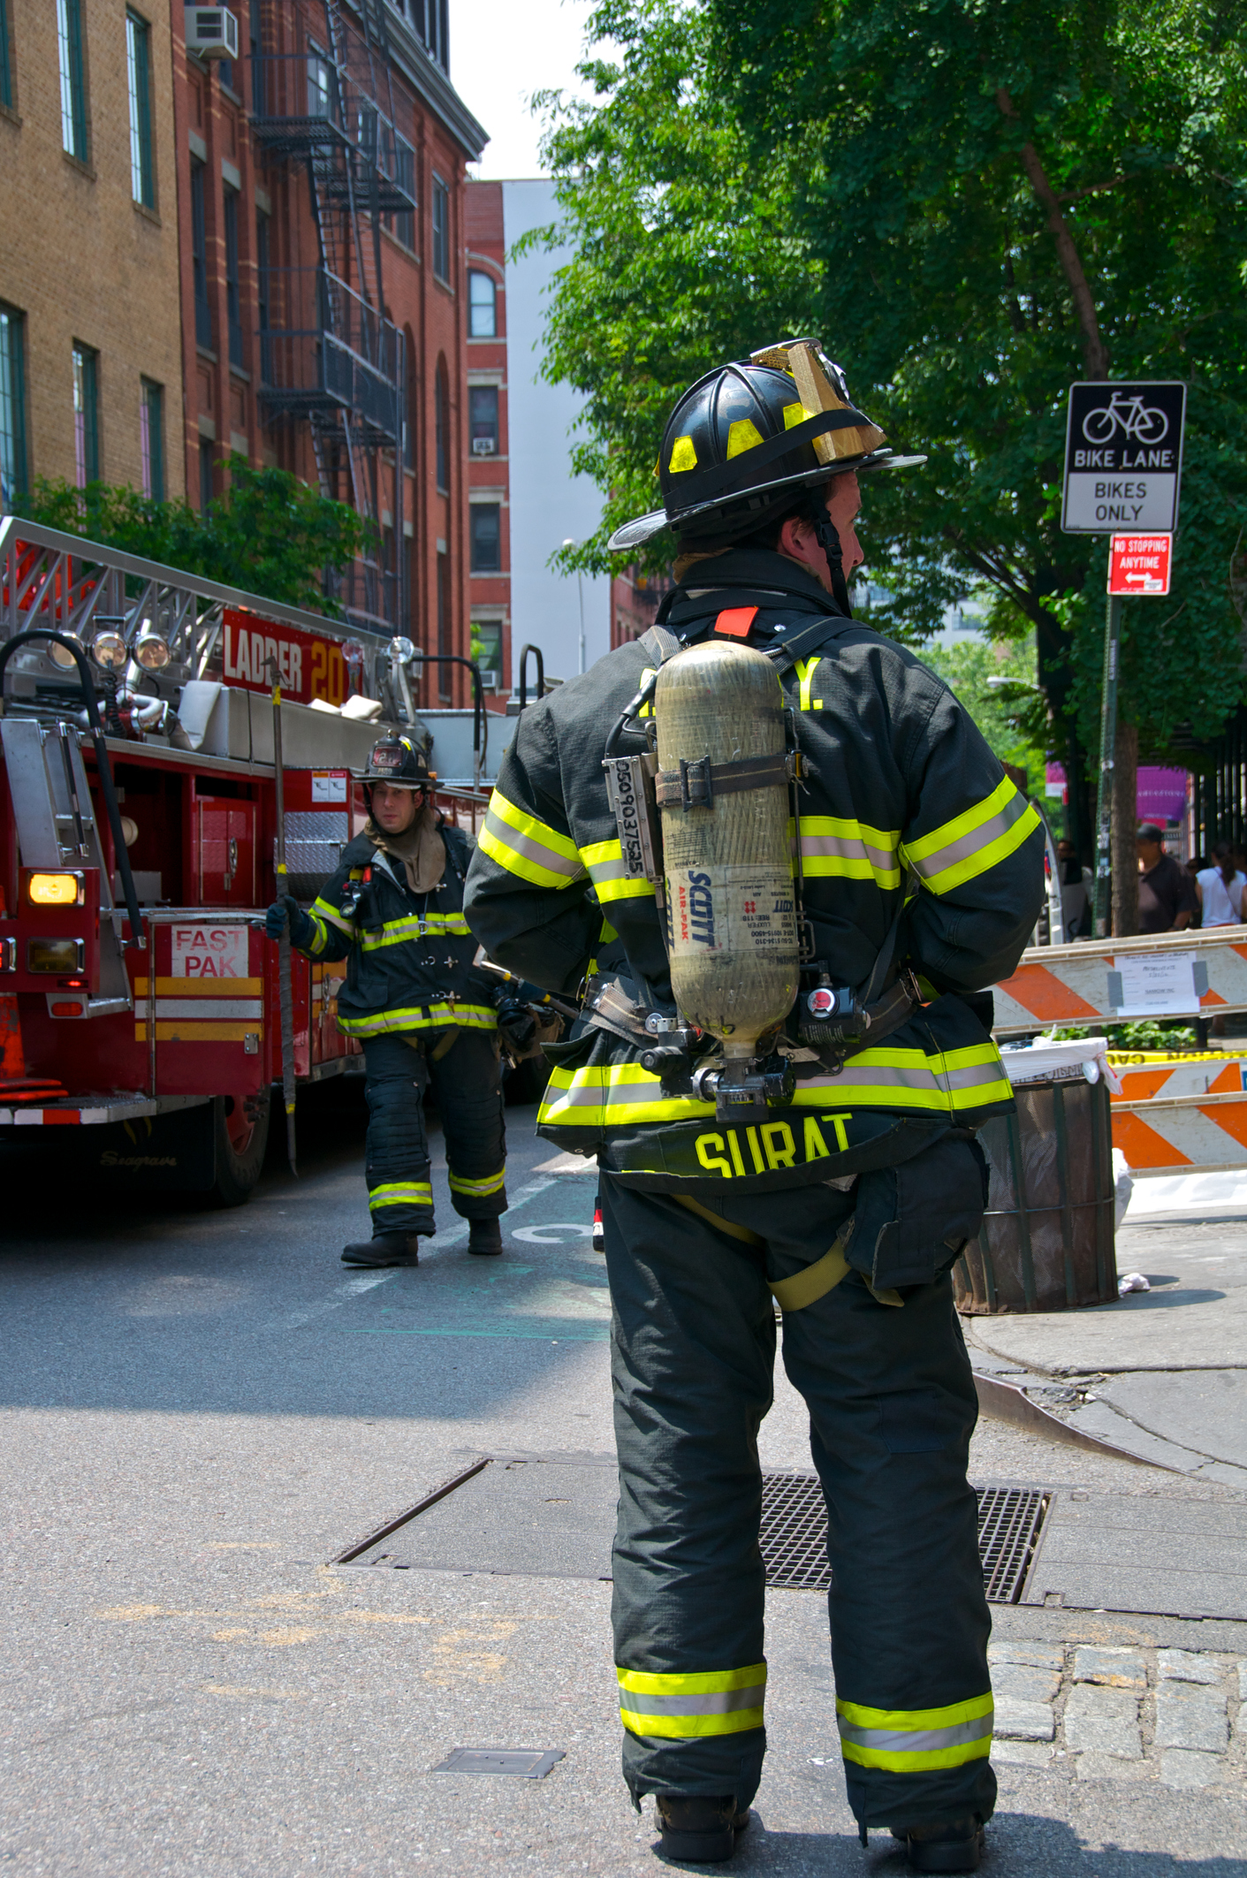
This year’s theme
BE AWARE – GET CHECKED
This theme focuses on the importance of annual medical evaluations/physicals and the Emergency Services Road Map to Health and Wellness. Firefighters face many increased health risks. Early detection saves lives and is critical to protecting our firefighters and responders.
The week is designed to increase awareness and action so that safety and health become a priority in all fire and emergency service departments.

Slide 4
Serve Strong: better you, better crew

Slide 5
A higher standard, for a higher risk…
NFPA’s Impact on Firefighter Health

Slide 6
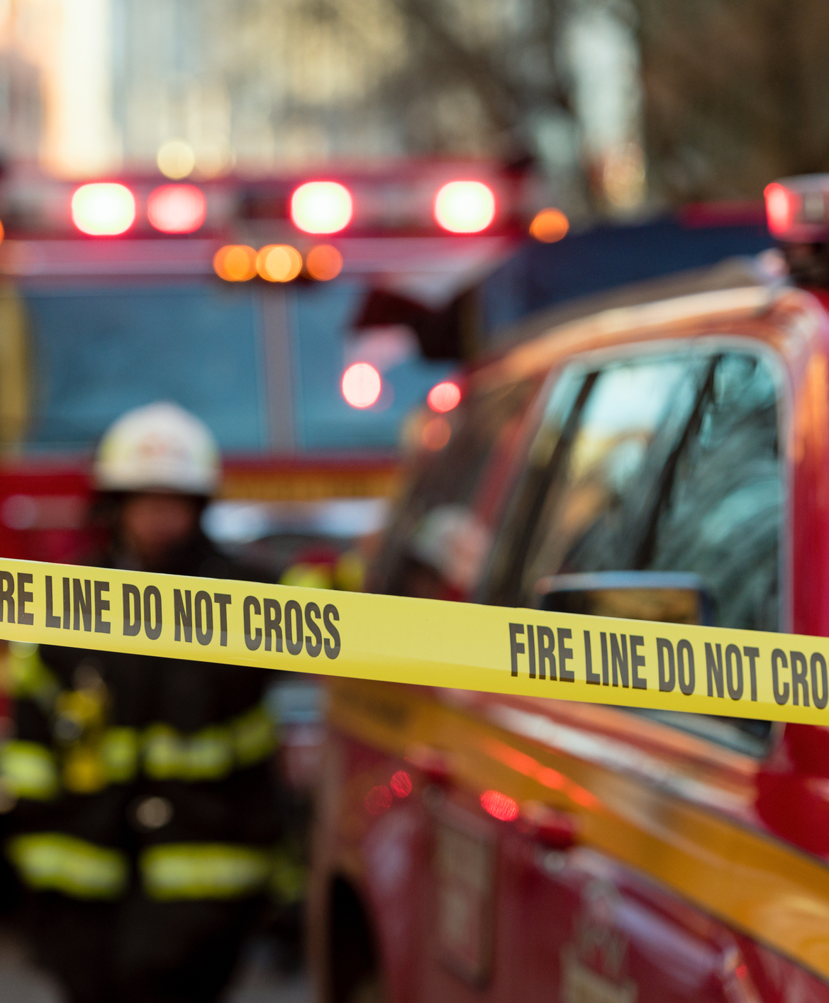
NFPA
NFPA 1582, Standard on Comprehensive Occupational Medical Program for Fire Departments This National Fire Protection Association (NFPA) standard outlines an occupational medical program that will reduce risks and provide for the health, safety, and effectiveness of firefighters operating to protect civilian life and property.
NFPA 1500, Standard on Fire Department Occupational Safety, Health, and Wellness Program This NFPA standard specifies the minimum requirements for an occupational safety and health program for fire departments or emergency service organizations.

Slide 7
NFPA (cont’d)
NFPA 1583, Standard on Health-Related Fitness Programs for Fire Department Members This NFPA standard outlines a complete health-related fitness program for members of fire departments involved in emergency operations to enhance their ability to perform occupational activities and reduce the risk of injury, disease, and premature death.
NFPA 1584, Standard on the Rehabilitation Process for Members During Emergency Operations and Training Exercises This NFPA standard establishes the minimum criteria for developing and implementing a rehabilitation process for fire department members at incident scene operations and training exercises.

Slide 8
A Healthcare Provider’s Guide to Firefighter Physicals
What Your Doctor Doesn’t Know CAN Hurt You!

Slide 9
Inside the guide
The International Association of Fire Chiefs (IAFC) and their Firefighter Safety Through Advanced Research (FSTAR) program developed this guide that firefighters can bring to their physician to help them understand physiological demands of firefighting and the resulting health risks research shows firefighters are most prone to.
The guide assists primary care providers in the evaluation, treatment, and ongoing surveillance of the unique health and wellness needs of firefighters.

Slide 10
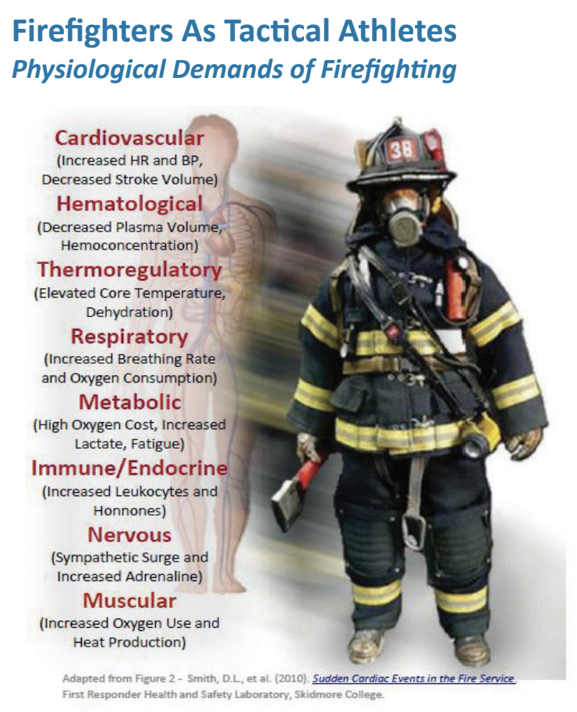
What we learned
Firefighters face unique occupational risks
Routinely operate in harsh environments
Wear more than 70lbs of equipment
Breathe compressed air
Doctors need to understand all of these

Slide 11
Your chances of sudden cardiac death
Increase with each of these factors

Slide 12
Know your Odds: Sudden Cardiac Death
Your risk increases with each of these activities

Slide 13
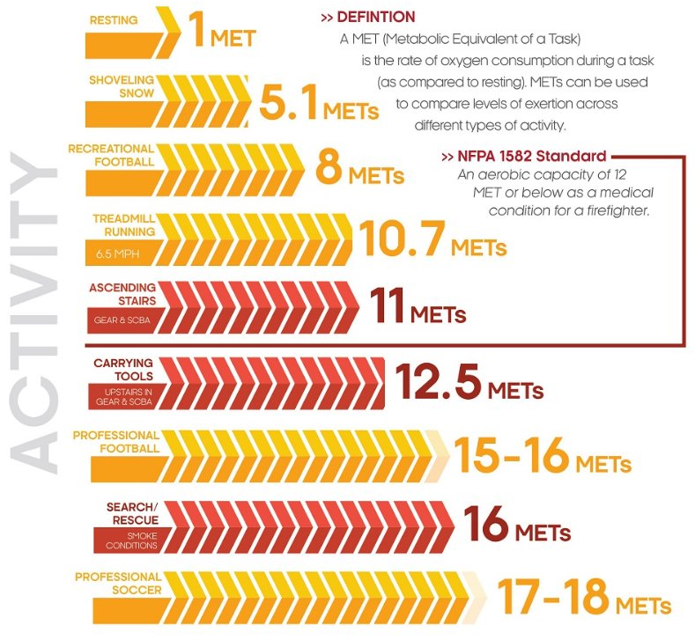
Know your mets
How does your exertion measure up?

Slide 14
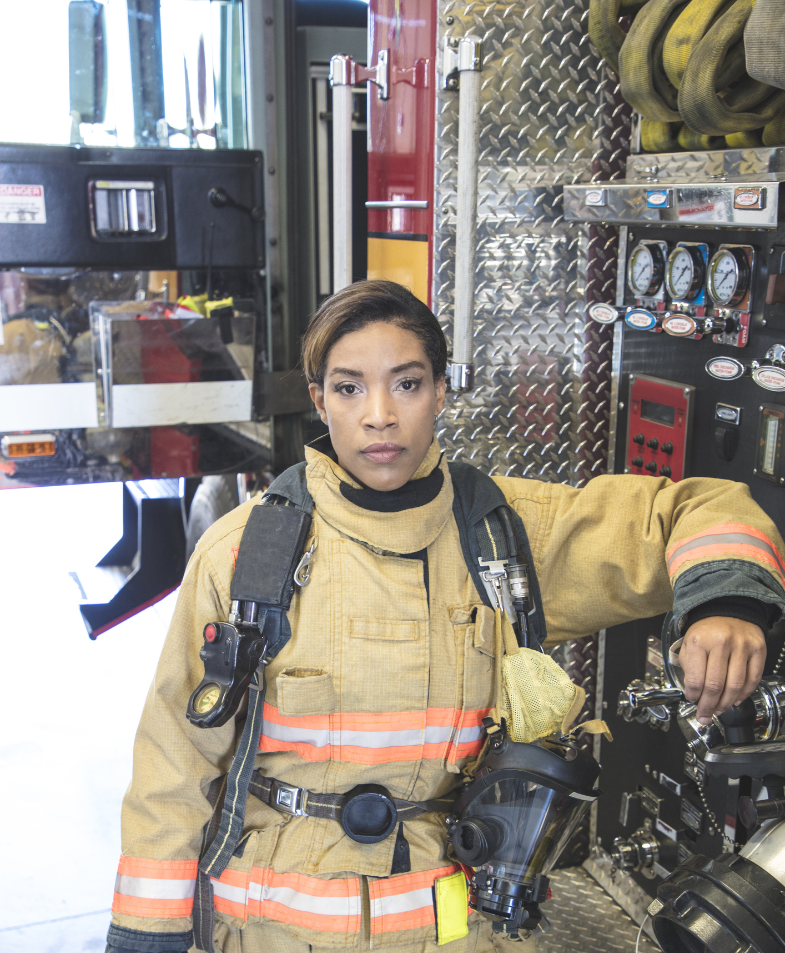
What your doc should check
Vitals
Multi-System Physical Exams
Labs
Testing
Family History
Personal Health Behaviors

Slide 15
Cardiovascular health & Fitness
Significant cardiovascular demands of firefighting lead to acute coronary events that account for 45% of deaths among on-duty firefighters, in contrast to 15% of all deaths occurring on conventional jobs.
Myocardial infarction is the leading cause of death of firefighters, and these events occur almost exclusively in susceptible firefighters with underlying cardiovascular disease (CVD).
It is therefore prudent to thoroughly screen for, and aggressively treat, all CVD risk factors, including diabetes, in this very high risk group of patients.

Slide 16
Cancer
Chronic exposures to heat, smoke, and toxic flame retardants through inhalation, ingestion, and skin absorption put firefighters at risk for many cancers.
The National Institute for Occupational Safety and Health (NIOSH) performed a multi-year study of nearly 30,000 firefighters to better understand the potential link between firefighting and cancer. The firefighters studied showed higher rates of certain types of cancer than the general U.S. population in digestive, oral, respiratory, and urinary cancers.

Slide 17
Take action to prevent cancer

Slide 18
PREVENT CANCER AND SERVE STRONG

Slide 19
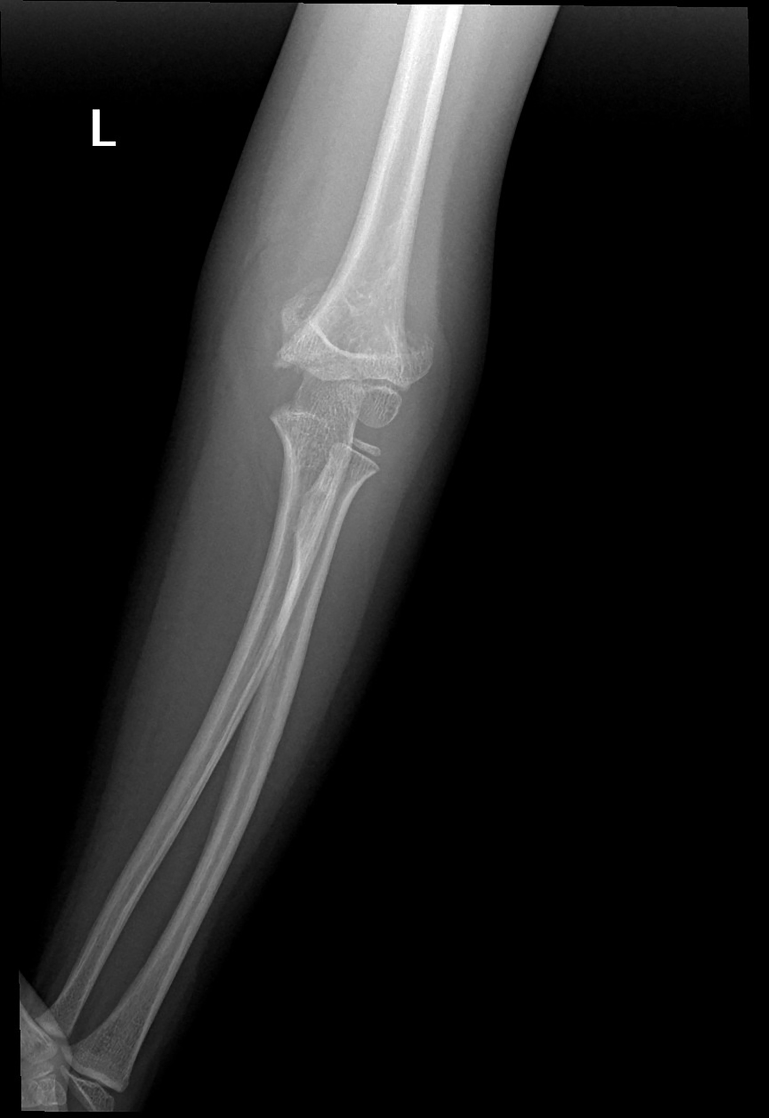
Musculoskeletal injuries
The high intensity and dynamic work environment of firefighting leads to a high incidence of musculoskeletal injuries. Low back injuries represent approximately 50% of all job related musculoskeletal injuries among firefighters.
These include strains, sprains, and intervertebral disc injuries, often leading to significant morbidity with the possibility of permanent disability. Obesity and deconditioning are strong predictors of musculoskeletal injuries.

Slide 20
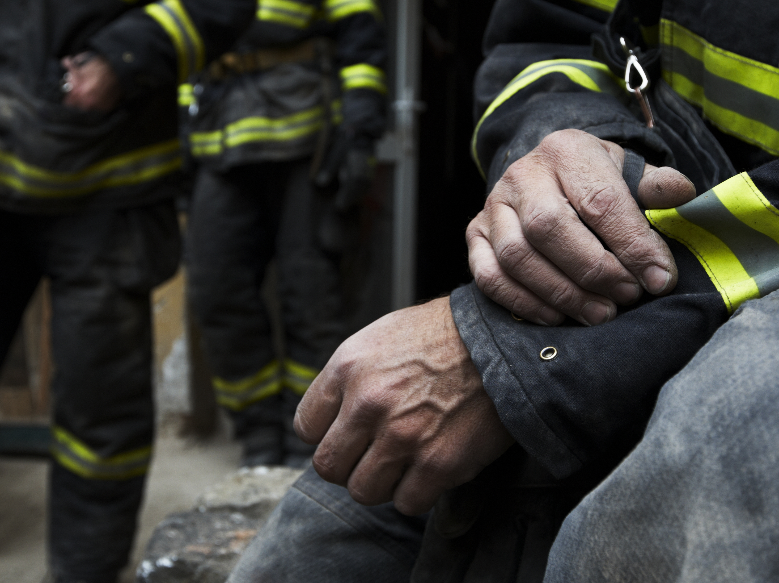
Behavioral Health
The mental and physical stress of firefighting and repeated exposure to trauma can lead to depression, anxiety, acute stress reactions, post-traumatic stress, and suicidal ideation.
Self-medication with alcohol and drugs can result in substance abuse disorders.

Slide 21
BEHAVIOR HEALTH: UNDERSTAND THE RISKS AND KNOW THE SIGNS

Slide 22
The emotional toll of being a firefighter

Slide 23
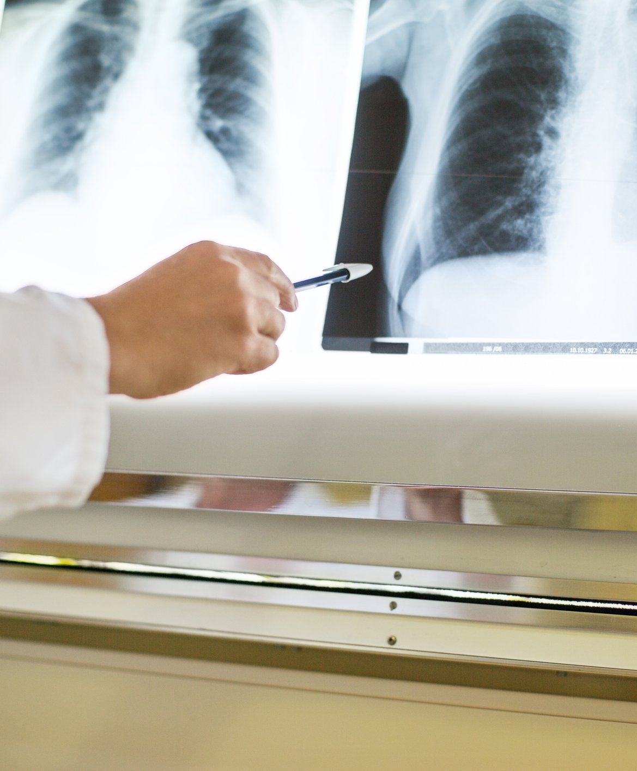
Lung Disease
In the line of duty, firefighters are often exposed to carbon monoxide and other inhaled toxins, or irritants that may lead to acute respiratory issues such as hypoxemia or bronchoconstriction.
Repeated exposure may cause chronic pulmonary disease and abnormal lung function.
Changes in lung function and the development of lung disease may be detected with baseline and periodic assessment.

Slide 24
Sleep Disorders
Sleep disorders are highly prevalent in firefighters and include sleep apnea, insomnia, shift-work disorder, and restless leg syndromes.
It is imperative to screen firefighters for these disorders since they substantially increase the risks for motor vehicle accidents, cardiovascular disease, diabetes, depression, and anxiety in firefighters.

Slide 25
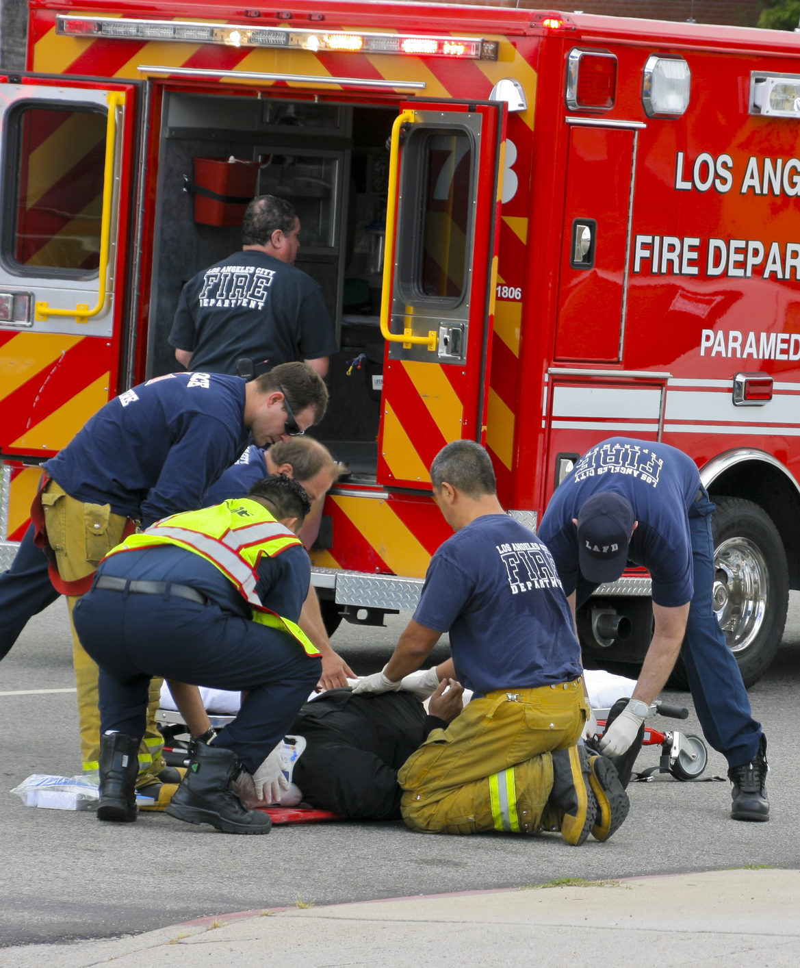
Infectious Diseases
Firefighters are often first on the scene of an emergency and may be exposed to HIV, hepatitis (A, B and C), TB and other infectious diseases.

Slide 26
Start your personal journey today
The Emergency Services Road Map to Health and Wellness

Slide 27
Information and sample documents to assist with education and implementation of a comprehensive wellness program.
to Health and

Slide 28
Why a road map?
In 2013, "The Fire Department Guide to NFPA 1582" was deployed to provide fire departments with a tool to better understand and use the NFPA 1582 "Standard on Comprehensive Occupational Medical Program for Fire Departments". In 2015, the Safety, Health and Survival Section, with support from the IAFC, took on the challenge to gain a better understanding of the status of firefighter specific medicals in the U.S. Fire Service and to find a way to get every firefighter an annual medical.

Slide 29
What’s inside
NFPA 1582 Q & A
Fire Administration Responsibilities
Healthcare Provider Responsibilities
A comprehensive pathway to supporting firefighter health and wellness
Firefighter
City/County Officials
Labor
Family & Friends

Slide 30
NFPA 1582
Q&A – General ?’s

Slide 31
Where can I get a copy of NFPA 1582?
Copies of NFPA 1582 are available at www.nfpa.org. This document can be purchased (hardcopy or electronic) or viewed, for free, on the NFPA site.

Slide 32
What does NFPA 1582 cover?
NFPA 1582 contains descriptive requirements for a comprehensive occupational medical program for fire departments and provides three main functions for incumbent members.

Slide 33
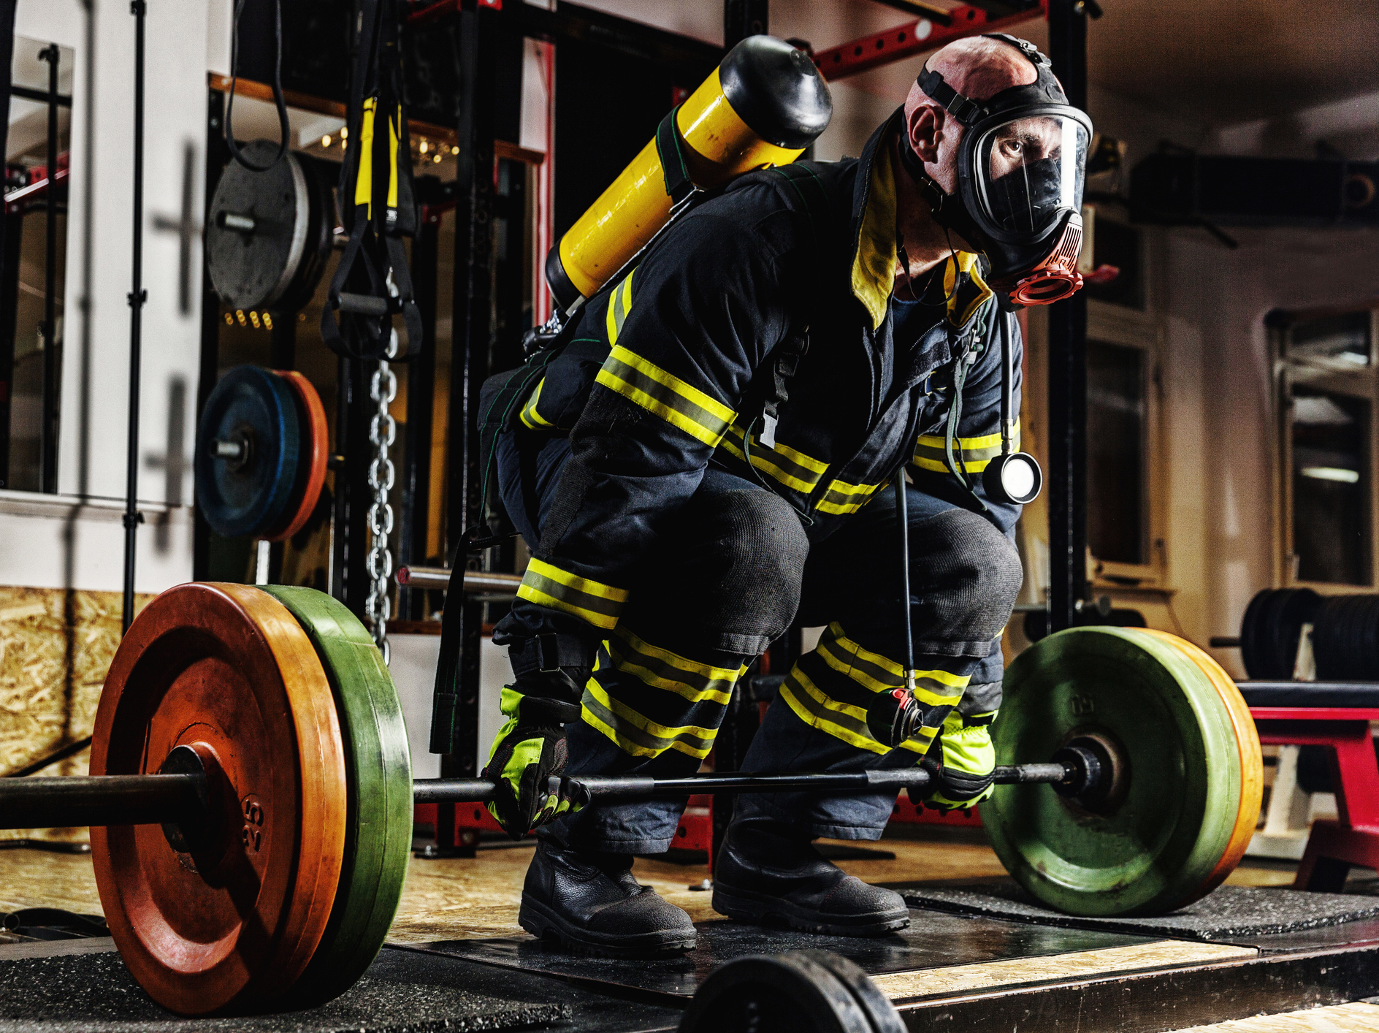
MAIN FUNCTIONS
Provides measurements to ensure a member is able to perform their essential job functions.
Provides a member insights to their fitness level and to encourage them to improve.
Provides referenced screening tools.

Slide 34
Are there departments that have fully implement NFPA 1582 as their annual medical standard?
Yes.
If interested, email inquiries can be sent to fstar@iafc.org and we will help you find a fire department in your area that has implemented the NFPA 1582 standard.

Slide 35
Have any departments implemented mandatory, annual NFPA 1582-compliant medicals?
Yes, there are both career, combination, and volunteer departments around the country that have implemented a mandatory, annual NFPA 1582 compliant medical.

Slide 36
Is there data about job loss in departments with mandatory programs?
There is only antidotal evidence at this time, but it is positive.
Yes, one of the main concerns about implementation of a 1582 program is that it will lead to mass disqualification of firefighters. This is simply not the case.
In organizations that have implemented a mandatory fire department medical program, a very limited number of firefighters have been removed from duty, or placed on light duty, due to an annual medical exam. Remember, NFPA 1582 is not a punitive process.
A properly administered 1582 program should result in an increasingly healthy and fit department.

Slide 37
Are there supporting NFPA standards to 1582?
A selection of supporting standards is listed below. All NFPA standards are available at www.nfpa.org.
Documents can be purchased (hardcopy or electronic) or viewed for free on the NFPA website.

Slide 38
Support from Standards
NFPA 1500: Standard on Fire Department Occupational Safety and Health Programs
NFPA 1006: Standard for Technical Rescue Personnel Professional Qualifications
NFPA 1001: Standard for Fire Fighter Professional Qualifications
NFPA 1003: Standard for Airport Firefighter Professional Qualifications
NFPA 1002: Standard for Fire Apparatus Driver/Operator Professional Qualifications
NFPA 1583: Standard on Health-Related Fitness Programs for Fire Department Members

Slide 39
Support from Standards (Cont’d)
NFPA 1021: Standard for Fire Officer Professional Qualifications
NFPA 1051: Standard for Wildland Firefighter Professional Qualifications
NFPA 1561: Standard for Emergency Services Incident Management System
NFPA 1581: Standard on Fire Department Infection Control Program
NFPA 1584: Standard on the Rehabilitation Process for Members During Emergency Operations and Training Exercises

Slide 40
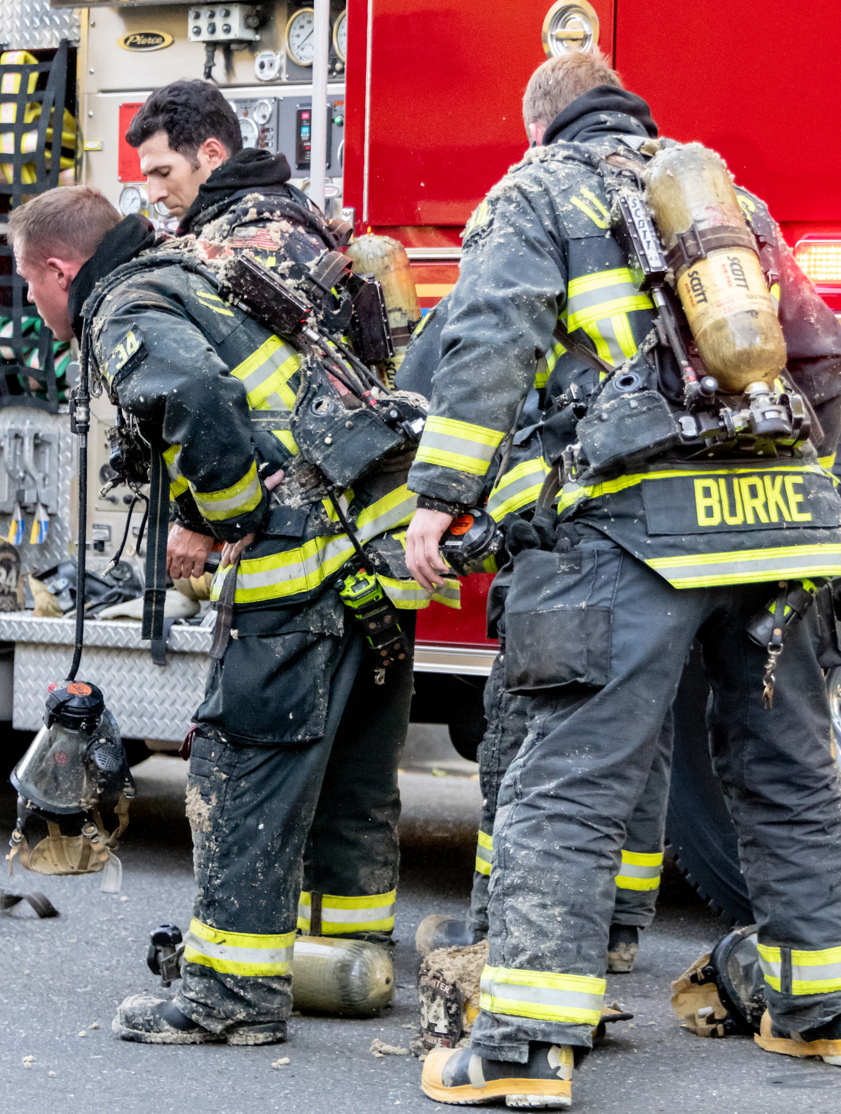
Where do I find specific medical conditions that have an effect on the essential job tasks?
In the NFPA 1582 document , check the Table of Contents (page 4) for a list of medical conditions.

Slide 41
Medical conditions effecting incumbent task ability
1. Cardiovascular Disorders
2. Vascular Disorders
3. Endocrine and Metabolic Disorders
4. Lung, Chest Wall, and Respiratory Disorders
5. Infectious Diseases
6. Spine Disorders
7. Orthopedic Disorders
8. Disorders Involving the Gastrointestinal Tract and
Abdominal Viscera
9. Medical Conditions Involving Head, Eyes, Ears, Nose,
Neck, or Throat
10. Neurologic Disorders
11. Psychiatric and Psychologic Disorders
12. Substance Abuse
13. Medications
14. Tumors — Malignant or Benign
15. Pregnancy and Reproduction

Slide 42
Medical Conditions effecting candidate’s task ability
1. Head and Neck
2. Eyes and Vision
3. Ears and Hearing
4. Dental
5. Nose, Oropharynx, Trachea,
6. Esophagus and Larynx
7. Lungs and Chest Wall
8. Aerobic Capacity
9. Heart and Vascular System
10. Abdominal Organs and Gastrointestinal System
11. Metabolic Syndrome
12. Reproductive System
13. Urinary System
14. Spine and Axial Skeleton Extremities
15. Neurological Disorders
16. Skin
17. Blood and Blood-Forming Organs
18. Endocrine Metabolic Disorders
19. Systemic Diseases and Miscellaneous Conditions
20. Tumors and Malignant Diseases
21. Psychiatric Conditions
22. Chemicals, Drugs, and Medication

Slide 43
Fire Administration

Slide 44
Be fit for your crew

Slide 45
Why is it important for members to have annual medical exams?
Members need to have an initial medical exam to establish an individualized baseline and to ensure they are healthy enough to be a firefighter. Thereafter, annual medical exams help to minimize the potential risk of significant medical events such as cardiac disease or cancer.

Slide 46
Get an Annual Physical and serve strong

Slide 47
How does a department start an annual medical/fitness program?
NFPA 1582 provides departments with guidance on how to build a comprehensive occupational medical program.
Visit www.nfpa.org to find resources on what you will need to start a program. Use government resources (local, state, and/or federal). Research what policies are already in place. If you are part of an agency, or the government that would be supporting a program, become familiar with current information.

Slide 48
EXAMPLES:
OSHA, NFPA, local county codes, employee manual, bargaining contracts.
NFPA 1582, 7.1.4, states the components of the medical evaluations shall conform to all applicable U.S. OSHA standards, including:
29 CFR 1910.120, “Hazardous waste operations and emergency response”
29 CFR 1910.134, “Respiratory protection”
29 CFR 1910.95, “Occupational noise exposure”
29 CFR 1910.1030, “Blood borne pathogens”

Slide 49
Who should be on the Health and Safety Committee?
A fire department physician, a health and safety officer, a health and fitness coordinator, a union representative and a risk manager are possible members.

Slide 50
What does the department need to know from the results of an annual medical exam?
Annual medical exams for incumbent members (as described in NFPA 1582, Chapters 7 and 9) give a healthcare provider guidance to determine if the member can properly perform the essential job tasks listed in Chapter 5.
Confidentiality must always be maintained for all members.
Members must be guaranteed and feel secure, that their medical information/data is kept private. The medical provider should only send the department information stating “qualified” or “not qualified” with applicable job limitations and restrictions regarding light duty when/if available.

Slide 51
What does the department need to know about candidate medical exams?
A candidate medical exam is for someone just entering the department. The medical exam will establish if they are medically able to do essential firefighter job tasks and will provide a baseline health exam prior to starting their role as a firefighter.

Slide 52
Why is the candidate medical exam different from an annual incumbent medicals exams?
The components of the medical exam are the same, but a candidate medical is broken down into two categories: A and B, as described in NFPA 1582, Chapter 6.
Medical conditions found in the A categories would preclude a candidate from being hired.

Slide 53
What is the connection between the medical exam and a firefighter’s essential job tasks?
Each medical component of the exam has a direct connection to the essential job tasks listed in Chapter 5 of NFPA 1582. If a member presents with a condition, injury or illness that may affect one of these job tasks, the appendices of the standard can help with determining the next step.

Slide 54
What happens if a member fails an annual medical exam?
Unless the member shares with you the reason they have failed, the department does not have the right to access personal health information.
That information is strictly held between the health care provider and the member. The healthcare provider shall report to the fire department as outlined in NFPA 1582.
Also, take into considerations that the failure may be due to a conditioning issue. Does your department have a NFPA 1583 B type physical fitness program?

Slide 55
What information does a member need to take to their personal healthcare provider?
Within this document are samples of information an incumbent member could take with them to their healthcare provider to assist with a firefighter-specific annual medical exam.

Slide 56
Information to Healthcare provider
The Healthcare Provider’s Guide to Firefighter Physicals
Letter to the Healthcare Provider
Self-Reported Job Impact (SRJI) Summary to inform provider of the members exposures
The essential job tasks list from NFPA 1582

Slide 57
What is the maximum allowable time between annual medical exams?
If there is an issue with completing the annual medical exam within 12 months, a grace period of ± 3 months is reasonable. If this is considered allowable, a written policy is recommended.

Slide 58
What should I expect of the healthcare provider?
A healthcare provider performing these types of exams needs to know the NFPA 1582 and other applicable standard and be able to competently interpret and execute them.
The provider should also be able to relate to firefighters to garner their trust and respect.
The department’s program manager needs to be confident in the provider’s ability to make informed, correct, decisions that may influence careers and impact the departments’ ability to safety provide service to the community.

Slide 59
Healthcare Provider

Slide 60
Why are we being asked to provide tests that insurance companies could find to be excessive for a healthy individual?
Insurance companies often do not understand the occupational risks associated with firefighting.
As such, checking the PSA levels or a heavy metal screening on a young incumbent or new hire may seem excessive.
In the litigious worker’s compensation world in which we operate, it is paramount to have baseline laboratory and other objective data that can be trended over time, as worker’s compensation cases will depend on baseline information.
The NFPA is clear that not every member needs every screening test every year, but a methodical approach to occupational surveillance with unbiased data for trending is appropriate.

Slide 61
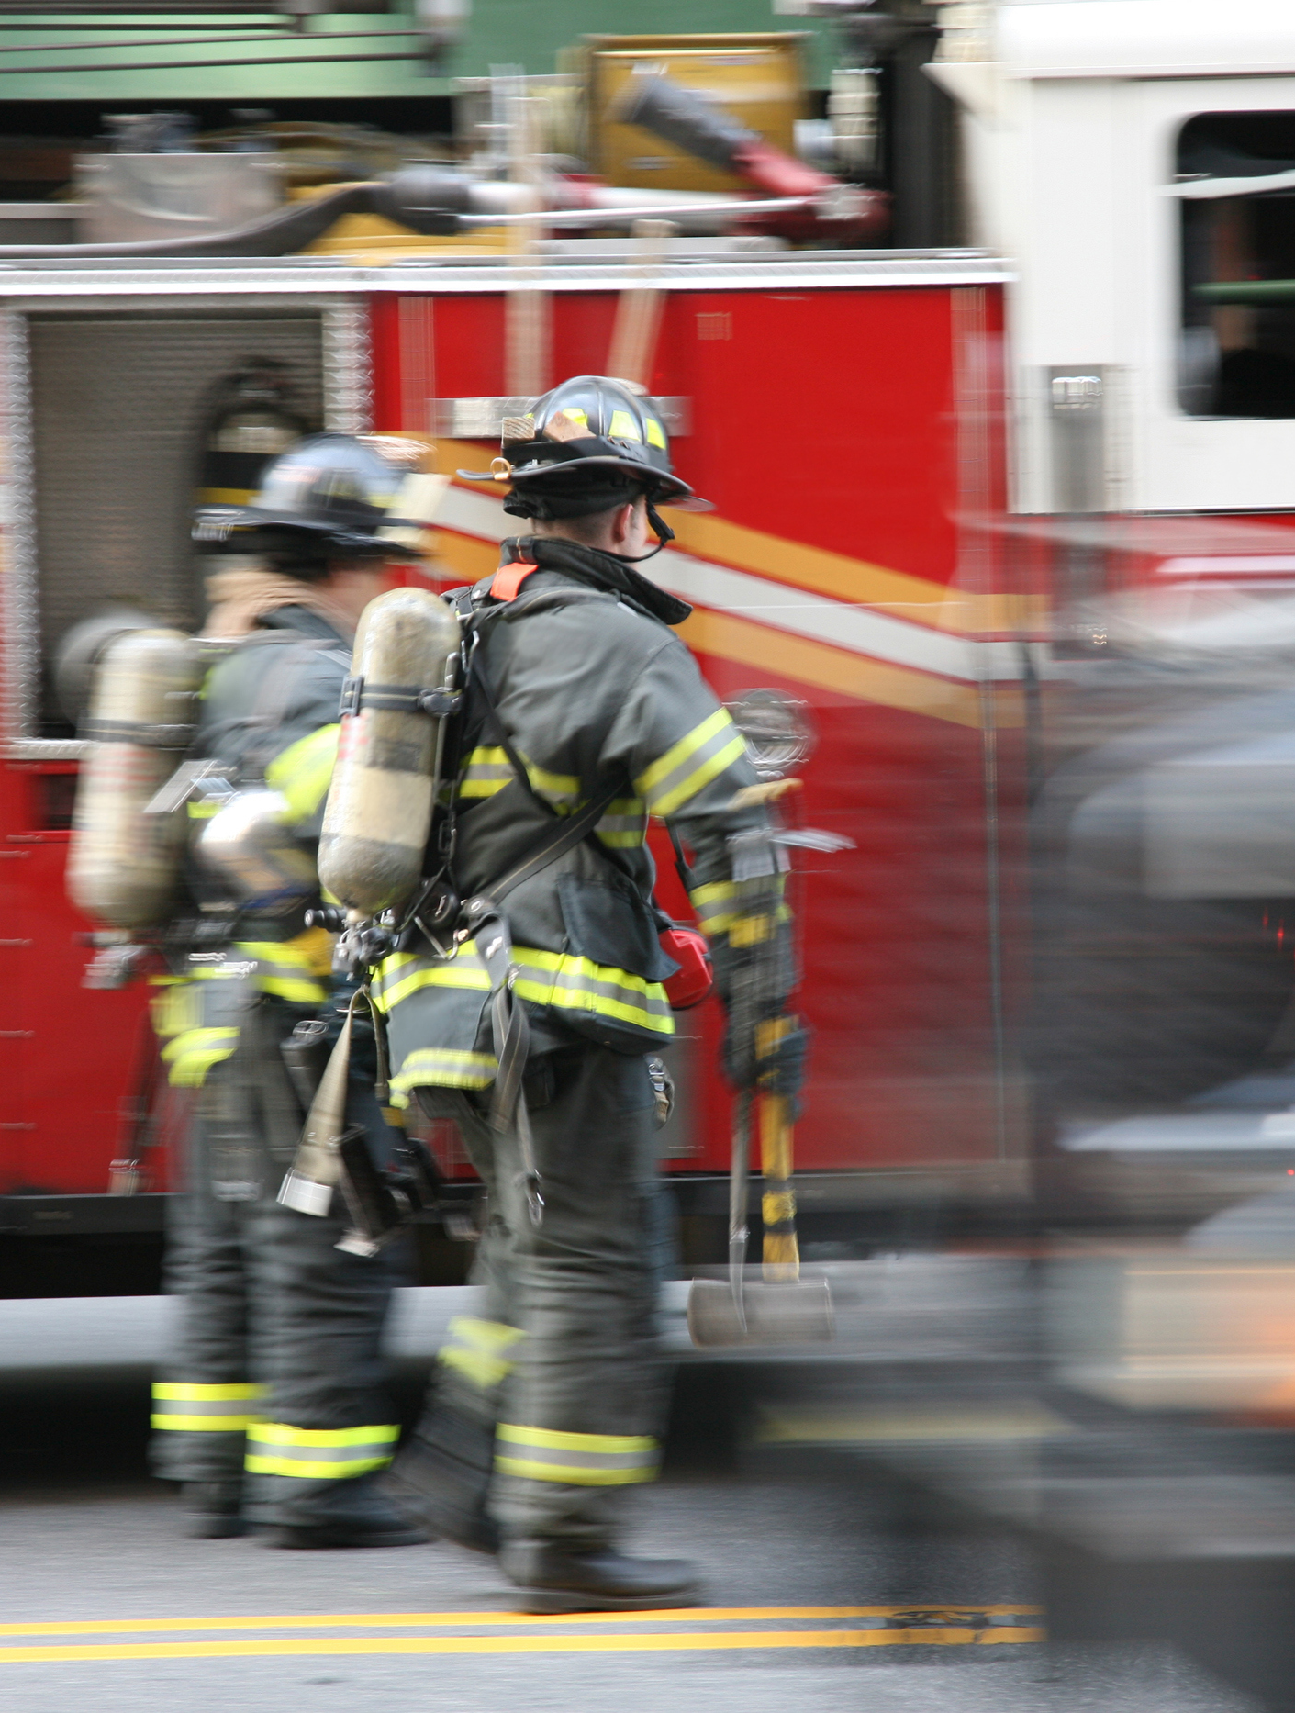
Are the medical exams outlined in NFPA 1582 required or recommended?
These are recommended standards applicable to public, governmental, military, private, and industrial fire department organizations providing rescue, fire suppression, emergency medical services, hazardous materials mitigation, special operations, and other emergency services.

Slide 62
How can preventive care be utilized when billing firefighter-specific exams?
The ICD-10 code Z00.00 (Encounter for general adult medical examination without abnormal findings) is good place to start. If a problem is discovered while performing preventative care, the appropriate ICD-10 diagnosis code would be reasonable to submit for billing purposes. The objective data obtained in the screening process is paramount for additional billing.

Slide 63
What is my responsibility to a department that contracts with me to conduct annual medical exams?
Your responsibility is to communicate in a timely and effective manner with the individual you are examining about their health and ability to perform their job safely.
Secondly, you are responsible for communicating to and with the department’s point of contact for annual medical exams (this most often is the Training or Safety Chief, but can be another designee of the Fire Chief) about members’ medical statuses. Develop a rapport and honest discussions with everyone involved. You are being paid for your accurate and expert medical opinion on each member’s ability to perform his or her duties.

Slide 64
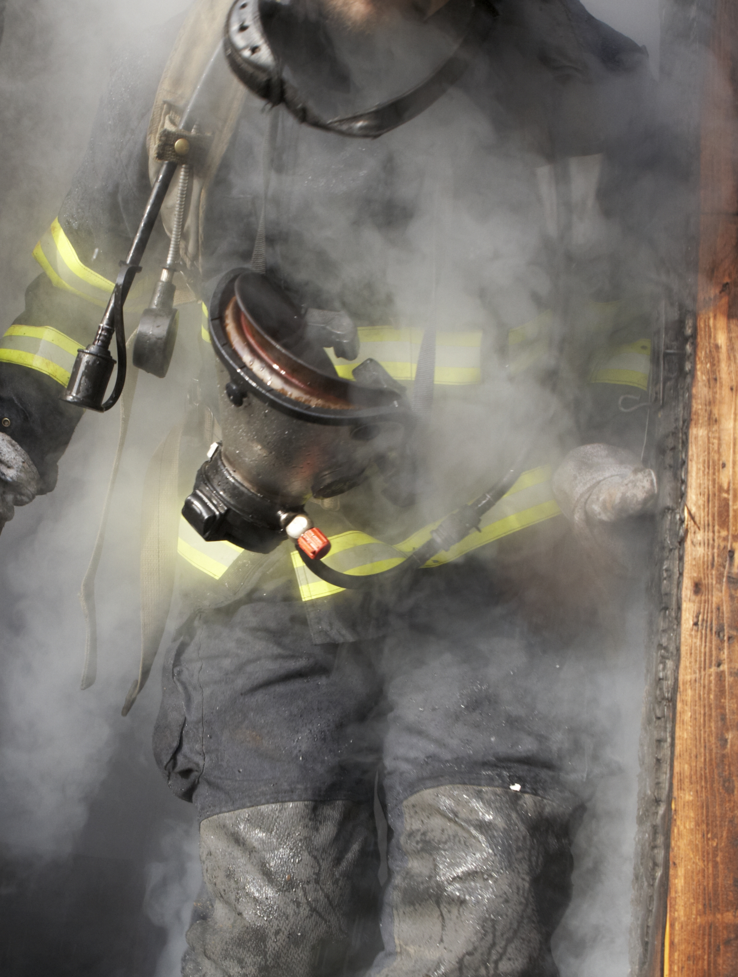
What is my role if I discover a patient cannot meet one of the essential tasks?
1) You MUST inform the member directly (in person as well as in writing.
2) You must also inform the Department’s Point of Contact for annual medical exams.

Slide 65
Role of findings and annual work statement
The Report of Findings is only for the member whom you have examined. Be very clear as to what the issue is and how it prevents them from safely preforming their job. Make evidence-based recommendations on the next step for the member’s care. HIPPA is not a concern when writing the Report of Findings as it is only intended for the member.
The Annual Work Statement is intended for public release (i.e., for the Fire Chief, Safety Officer, Training Chief, Human Resources, etc.). HIPPA is of great concern and you should only make generic statements that do not disclose any personal medical information without the written consent of the member. Clearly annotate on the Annual Work Statement whether the member can safely perform their job for the next 12 months.

Slide 66
Who pays for additional tests and/or follow-ups after the initial exam?
As department policies and procedures vary greatly, this question must be addressed during contract discussions before becoming a department’s healthcare provider.
It is possible that the individual’s health insurance may pay for the additional tests. The department may also elect to pay for any additional tests.

Slide 67
Are there sample documents available to help a fire department and a healthcare provider negotiate to a contract to provide annual medical exams?
Yes, many departments already have established programs that use contracted healthcare providers. A great resource for documents such as Request for Proposals (RFP) and Memorandum of Agreement (MOA) , is the International Association of Fire Chiefs (IAFC) KnowledgeNet. Healthcare providers are eligible for an IAFC associate membership. As a member, requests for specific information can be made on the KnowledgeNet site.

Slide 68
Does NFPA 1582 limit what a healthcare provider can do during an annual medical exam?
No, NFPA 1582 does not limit what is provided in an annual medical exam. NFPA 1582 outlines the minimum acceptable standard for what should be provided. Departments vary widely as to their priorities. It is prudent to discuss exam parameters with the department leadership prior to entering into a contract. Healthcare providers should be advocating for what is in NFPA 1582 as a minimum.

Slide 69
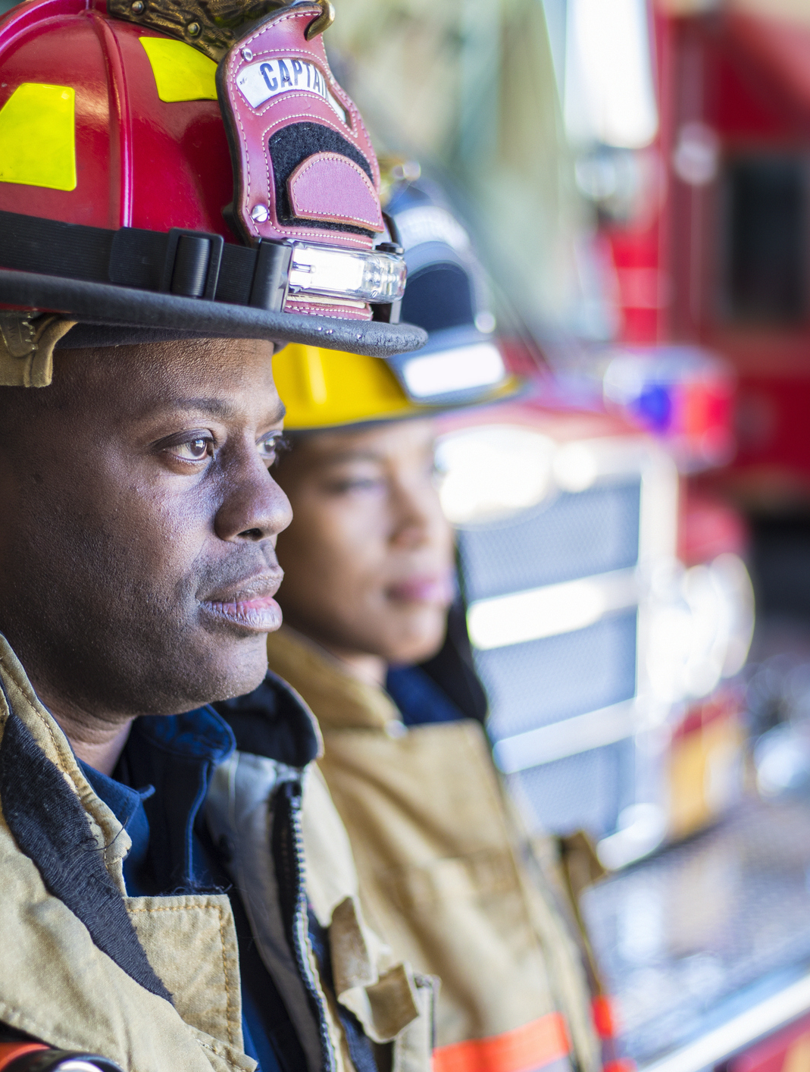
What are the pros and cons of providing annual medical exams for firefighters?

Slide 70
Pros
The pros of providing annual medical exams for firefighters include:
A generally healthy population;
Concerned about their health (which makes them good patients);
Interesting subject matter in providing occupational-specific medicine; and
Provides a service to the community that helps to ensure firefighters are capable of responding to the needs of their community safely.

Slide 71
Cons
The cons of providing annual medicals exams for firefighters include:
Potentially time-intensive and cumbersome contract negotiations and other requirements due to procurement rules for local municipalities;
Emotions of recommending removal of a firefighter from their job due to a medical condition;
Unless asked to perform additional services, almost all the members screened will be treated by their Primary Care physicians for follow-up of medical issues;
Knowledge of NFPA 1582, the Wellness-Fitness Initiative ( WFI ) and other fire service-specific recommendations are unique and require extensive research and understanding.

Slide 72
Risk/Benefit Manager

Slide 73
What is a fire department medical program?
It is a comprehensive occupational medical program for fire departments, including medical exams for candidates and incumbents. Additional components include comprehensive health, fitness, and safety programs.

Slide 74
Can we only implement portions of the medical program
Minimally, the IAFC recommends that a fire department medical program should include comprehensive, annual medical exams for all incumbent members and comprehensive baseline exams for all candidates.

Slide 75
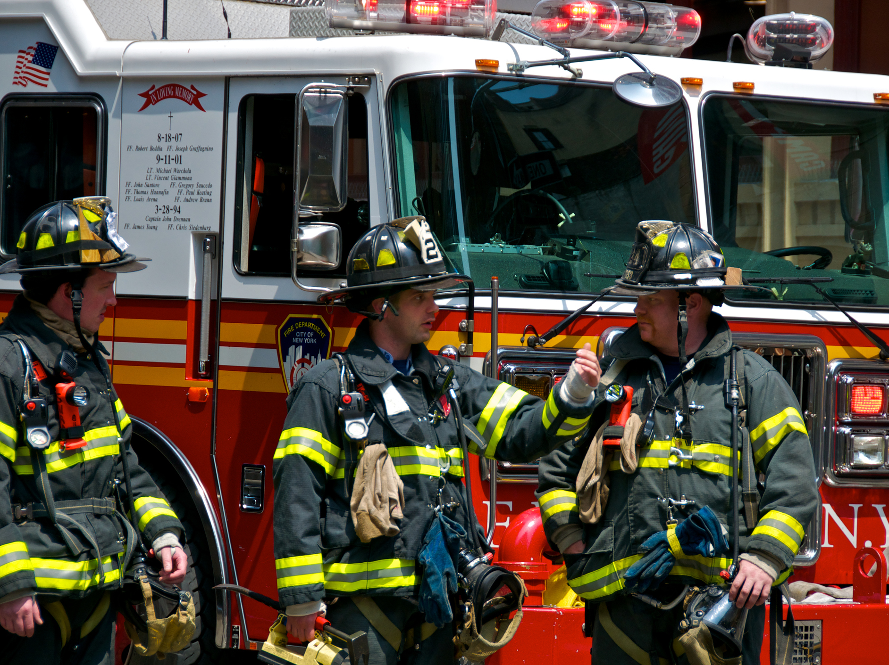
Why is a fire department medical program important?
Due to occupational demands, firefighters face extreme physical, mental, and environmental stresses resulting in increased risk of morbidity and mortality for cardiovascular events, musculoskeletal injuries, behavioral health issues, and cancer. Early detection of underlying medical conditions and participation in annual medical exams is critical to saving firefighter lives and improving quality of life.

Slide 76
How much is it going to cost? Can we only implement portions of the medical program?
The costs for a fire department medical program vary by department and region. In the original “A Fire Department’s Guide to Implementing NFPA 1582”, four WFI departments outline their startup and savings costs. If you already have some components of the fire department medical program, your costs may be reduced.

Slide 77
Who pays for follow-up care when a member completes a medical exam and needs additional care?
This will depend on the organization’s resources and the care needed. Follow-up care may take place at employee health clinics, through a Primary Healthcare Provider, and/or through a referral to specialists. It is important that the fire department outline all components of their medical program to include such items as follow-up care, return to work, and light duty.

Slide 78
We already offer medical insurance. How is a fire department medical program different?
While an annual medical exam with a general practitioner is good, the average healthcare provider is not well-versed in the essential job functions and environmental working conditions of a firefighter. Due to the demands of firefighting, the fire department medical exam has components that an annual exam with a Primary Healthcare Provider may not have, including immunizations, hearing and vision tests, pulmonary function, stress test, chest x-ray, heavy metal screenings, and certain laboratory tests not usually conducted during a regular annual medical exam. A fire department medical program conducts comprehensive health evaluation that address the physical requirements necessary to withstand the extreme conditions a firefighter faces on the job.

Slide 79
How is a medical program going to impact the organization’s medical, pharmacy, and other benefit claims?
As with any medical evaluation, there may be medical conditions that were previously unknown, which will treatment and follow-up care. This early detection may increase medical and pharmacy plan costs early on, however, late detection may substantially increase costs, when treatment and recovery may not be viable options. How these costs will impact your claims experience will depend on whether you provide health insurance and if it is fully-insured or self-insured.

Slide 80
How is the medical program going to affect our operations? Will more employees be on light duty or forced to retire?
The health of your firefighters is of greatest importance. In organizations that have implemented a mandatory fire department medical program, a very limited number of firefighters have been removed from duty or placed on light duty due to an annual medical exam. The NFPA 1582 guidelines provide evaluating healthcare providers professional criteria to be followed in evaluating a member’s health against the occupational risks. The goal of a medical evaluation program is not to remove firefighters from duty. It is to protect their health and safety by ensuring that a firefighter is medically capable to meet the demands of the job.

Slide 81
What is the risk to the organization if we do not implement a program?
Recent studies and surveys suggest there is a serious gap in the healthcare of firefighters.
Left undiagnosed, serious illness can lead to no longer being able to do the job or worse – death.

Slide 82
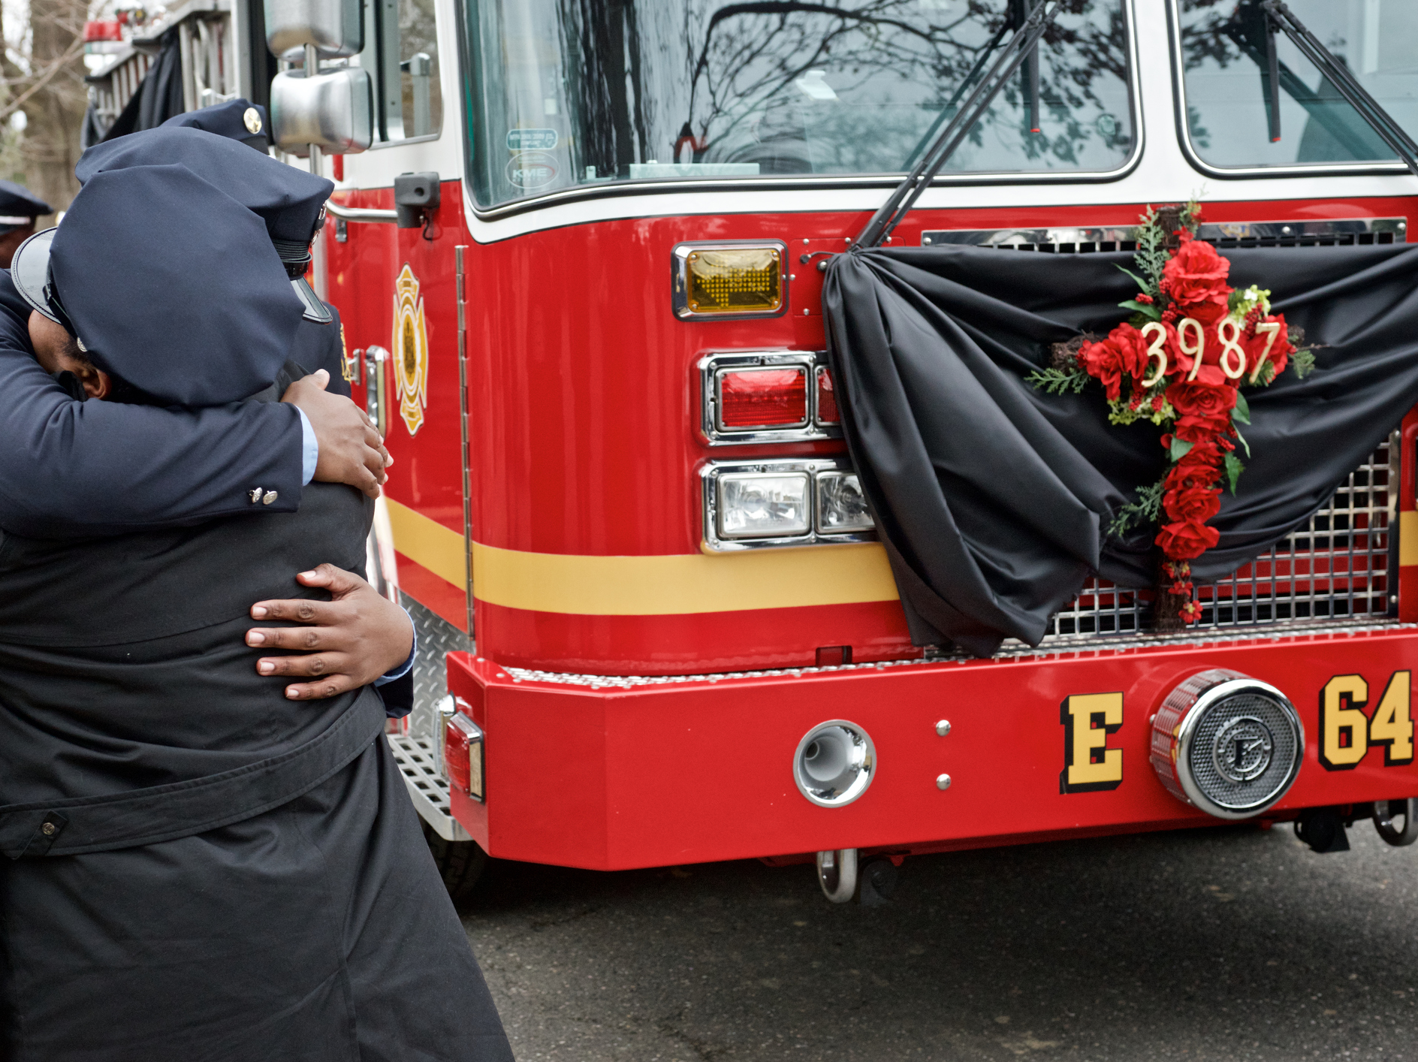
RISK
According to the National Fire Protection Association’s Firefighter Fatalities in the United States-2016, cardiac-related events accounted for 38 percent of firefighter deaths in 2016, and 42 percent over the past 10 years.
Research by Denise Smith, PhD, and others found for every line-of-duty death there are an estimated 17 nonfatal cardiac events on duty among firefighters.
There are immediate and long-term health risks associated with firefighting and fire departments have an obligation to take care of their firefighters with a program that is tailored to the inherent risks of their dangerous jobs.

Slide 83
Who in the organization is responsible for the implementation of the medical program?
The answer to this question will be specific to the organization. A collaborative approach would include personnel from the fire department, labor, human resources, procurement, budget department, risk management, and the organization’s leadership.

Slide 84
How does a fire department medical program fit into the organization’s overall benefits strategy?
It is one component of an organization’s comprehensive benefits strategy. Organizations provide benefits in order to recruit and retain employees, but also to keep them well and fit. A medical program provides health and financial security through annual evaluation with an emphasis on early detection. The increased morbidity and mortality related to firefighting work can be devastating to a career, financial security, and families. The goal is to help firefighters remain healthy and on-duty, benefitting the employee and the organization who invested in their training and experience.

Slide 85
Everybody gets healthy.
We all go home!

Slide 86
Special Considerations for Volunteer fire departments

Slide 87
Considerations for Volunteer Departments
The NVFC supports annual medical assessments for all firefighters. However, it can be cost-prohibitive or administratively challenging for many volunteer departments to implement an assessment program. The following are options for departments to consider in developing a firefighter medical assessment program:
* Preventative Care Check – Generally available at no charge or low-cost through individual or employer-provided health insurance.
* DOT Physicals – Designed to confirm that someone is healthy enough to safely perform the job of commercial motor vehicle driver.
* Department-Specific Assessment – Many fire departments develop a medical assessment for their candidates and members that is based on the specific job duties and expectations of the agencies.
* NFPA 1592-Compliant Assessment – This standard presents requirements for a comprehensive occupational medical program for fire departments.

Slide 88
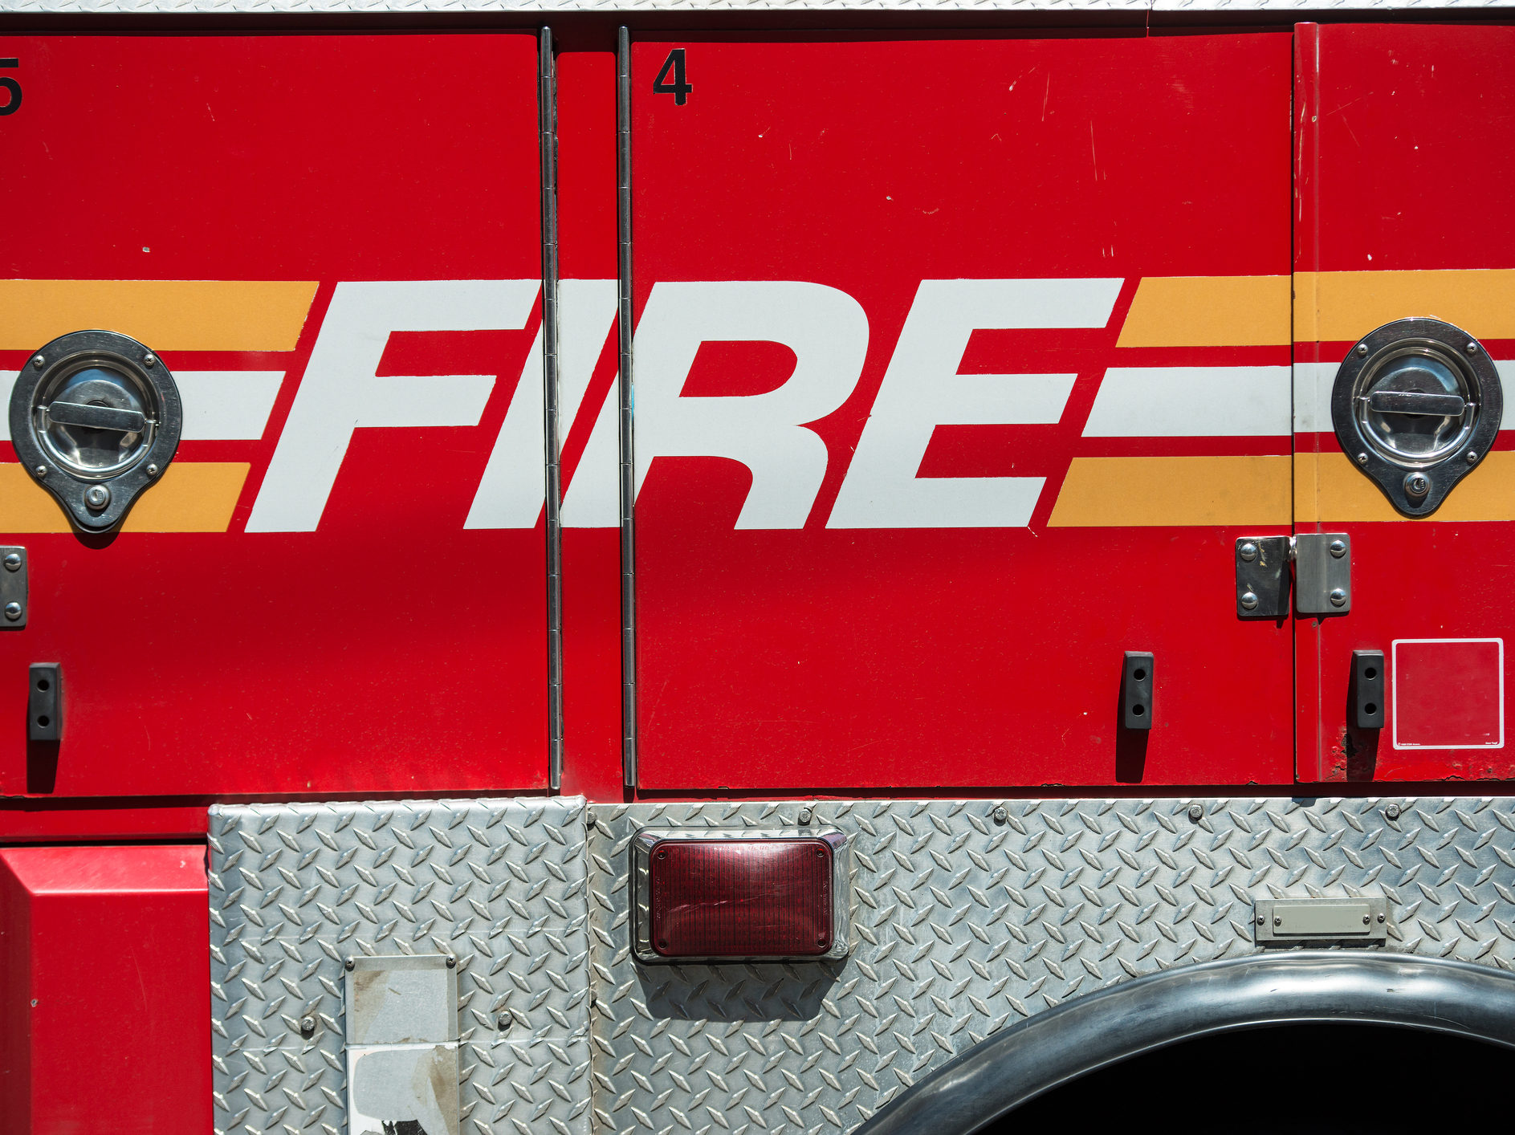
Programs

Slide 89
Programs
The Fire Service Joint Labor Management Wellness-Fitness Initiative The IAFC and International Association of Fire Fighters (IAFF) developed this program to help departments implement positive, individualized wellness-fitness programs.
Heart-Healthy Firefighter Program The NVFC Heart-Healthy Firefighter Program helps individual responders focus on their health and helps departments implement a health and wellness program.
Share the Load Program This NVFC program provides resources and tools to individuals, departments, and families to address behavioral health in the fire service.
Serve Strong We are stronger together, and we are strongest when healthy. The NVFC provides tools and resources to help responders Serve Strong for their crew and all who depend on them.

Slide 90
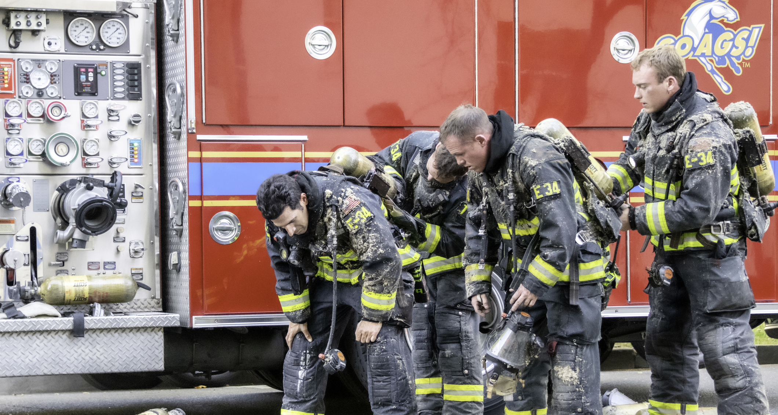
Training

Slide 91
Training
Cardiovascular & Chemical Exposure Risk Studies at IFSI Research This webinar, instructed by Gavin Horn, PhD, Director of Research for Illinois Fire Service Institute (IFSI), provides a high level overview of recent studies conducted at IFSI Research along with partners from UL FSRI and NIOSH to characterize some of the leading health risks on today’s fire ground and training ground.
Best Practices for Preventing Firefighter Cancer (Part 1 & 2) In the first of two webinars, the IAFC VCOS and NVFC present the first five of the 11 best practices for preventing firefighter cancer.
NVFC Virtual Classroom The NVFC Virtual Classroom contains dozens of courses including:
Cancer in the Fire Service: A Growing Epidemic
Preventing and Coping with Suicide in the Fire and Emergency Services
Behavioral Health in the Fire and Emergency Services
Health and Wellness Program Design

Slide 92
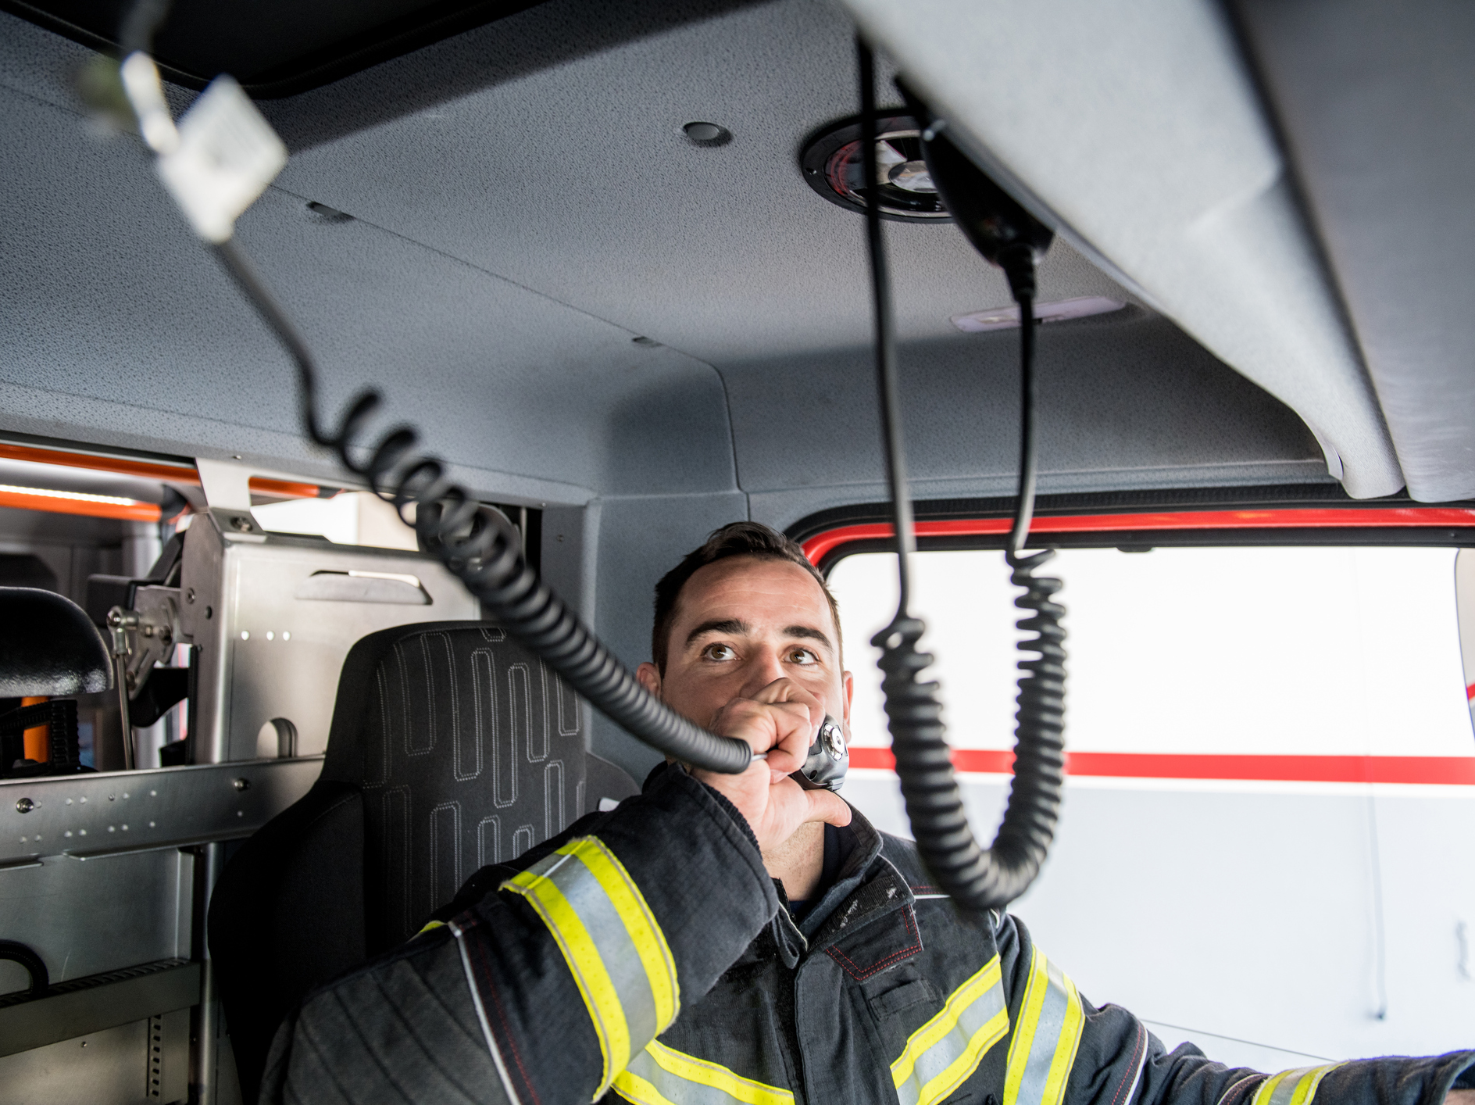
Reports

Slide 93
Reports
Effect of Heat Stress and Dehydration on Cardiovascular Function First Responder Health & Safety Laboratory, Health & Exercise Sciences, Skidmore College
Heart to Heart: Strategizing an Evidence-based Approach to Reduce Cardiac Disease and Death in the Fire Service Proceedings from a December 2015 conference hosted by the NFFF
Fire Service Occupational Cancer Alliance Report Proceedings from January 2015-Apil 2016
Post Traumatic Stress Disorder Among Career Professional Firefighters FSTAR Fact Sheet on 2011 study published in American Journal of Health Sciences

Slide 94
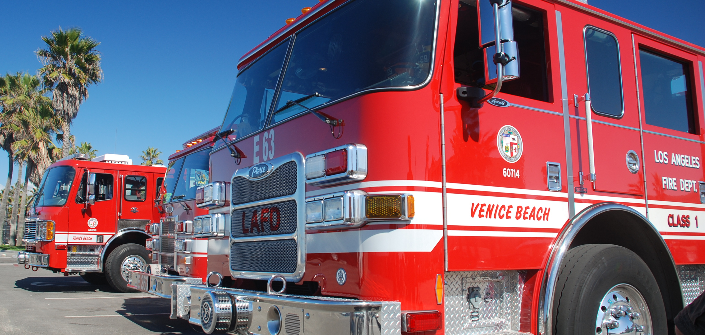
Additional Resources

Slide 95
Resources
NVFC Position on Firefighter Medical Assessments The National Volunteer Fire Council (NVFC) supports annual medical assessments for all firefighters, but understands the barriers and limitations that may exist. This document outlines several options for departments to consider in developing a firefighter medical assessment program.
NVFC Position Statement on Diabetes This statement from the NVFC looks at the prevalence and impact of diabetes in the fire service and the importance of annual medical assessments for all firefighters.
Understanding & Implementing NFPA Standards 1500, 1720, and 1851 This guide developed by the NVFC and NFPA is designed to help volunteer fire departments understand and implement NFPA standards, including 1500, Standard on Fire Department Occupational Safety, Health, and Wellness Program.

Slide 96
Resources
Volunteer Fire Service Culture: Essential Strategies for Success Chapter Five of this NVFC textbook focuses on health and wellness, including an in-depth discussion of firefighter medical exams.
Cancer Prevention Resources The NVFC has compiled resources and tools to help address and prevent firefighter cancer.
Best Practices for Preventing Firefighter Cancer The NVFC and the IAFC Volunteer and Combination Officers Section, along with the Fire Service Occupational Cancer Alliance, the Firefighter Cancer Support Network (FCSN), and with support from California Casualty, developed a poster that features 11 best practices to prevent firefighter cancer.

Slide 97
Resources
Health and Wellness Resources The NVFC has many resources, guides, and tools to help fire department leaders and personnel focus both on individual health and wellness as well as implement department-wide programs.
Firefighter Strong This newsletter contains articles and resources designed to help department members focus on some of the critical health and safety issues facing firefighters and EMS providers and start taking steps towards a safer, healthier department.
Fire/EMS Helpline Run by American Addiction Centers, the Fire/EMS Helpline is a free, confidential hotline that firefighters, EMS providers, and their families can call 24/7 to assist with behavioral health issues such as PTSD, stress or anxiety, depression, suicidal thoughts, addiction, and more.

Slide 98
Resources
Life Safety Initiative 6: Medical and Physical Fitness Firefighter Life Safety Initiative 6 states: Develop and implement national medical and physical fitness standards that are equally applicable to all firefighters, based on the duties they are expected to perform. This National Fallen Firefighters Foundation (NFFF) web site contains resources and information relating to this initiative.
Firefighter Cancer Support Network The Firefighter Cancer Support Network provides support and assistance to firefighters and their families in the event of a cancer diagnosis, as well as resources for firefighter cancer research and prevention.

