Slide 1
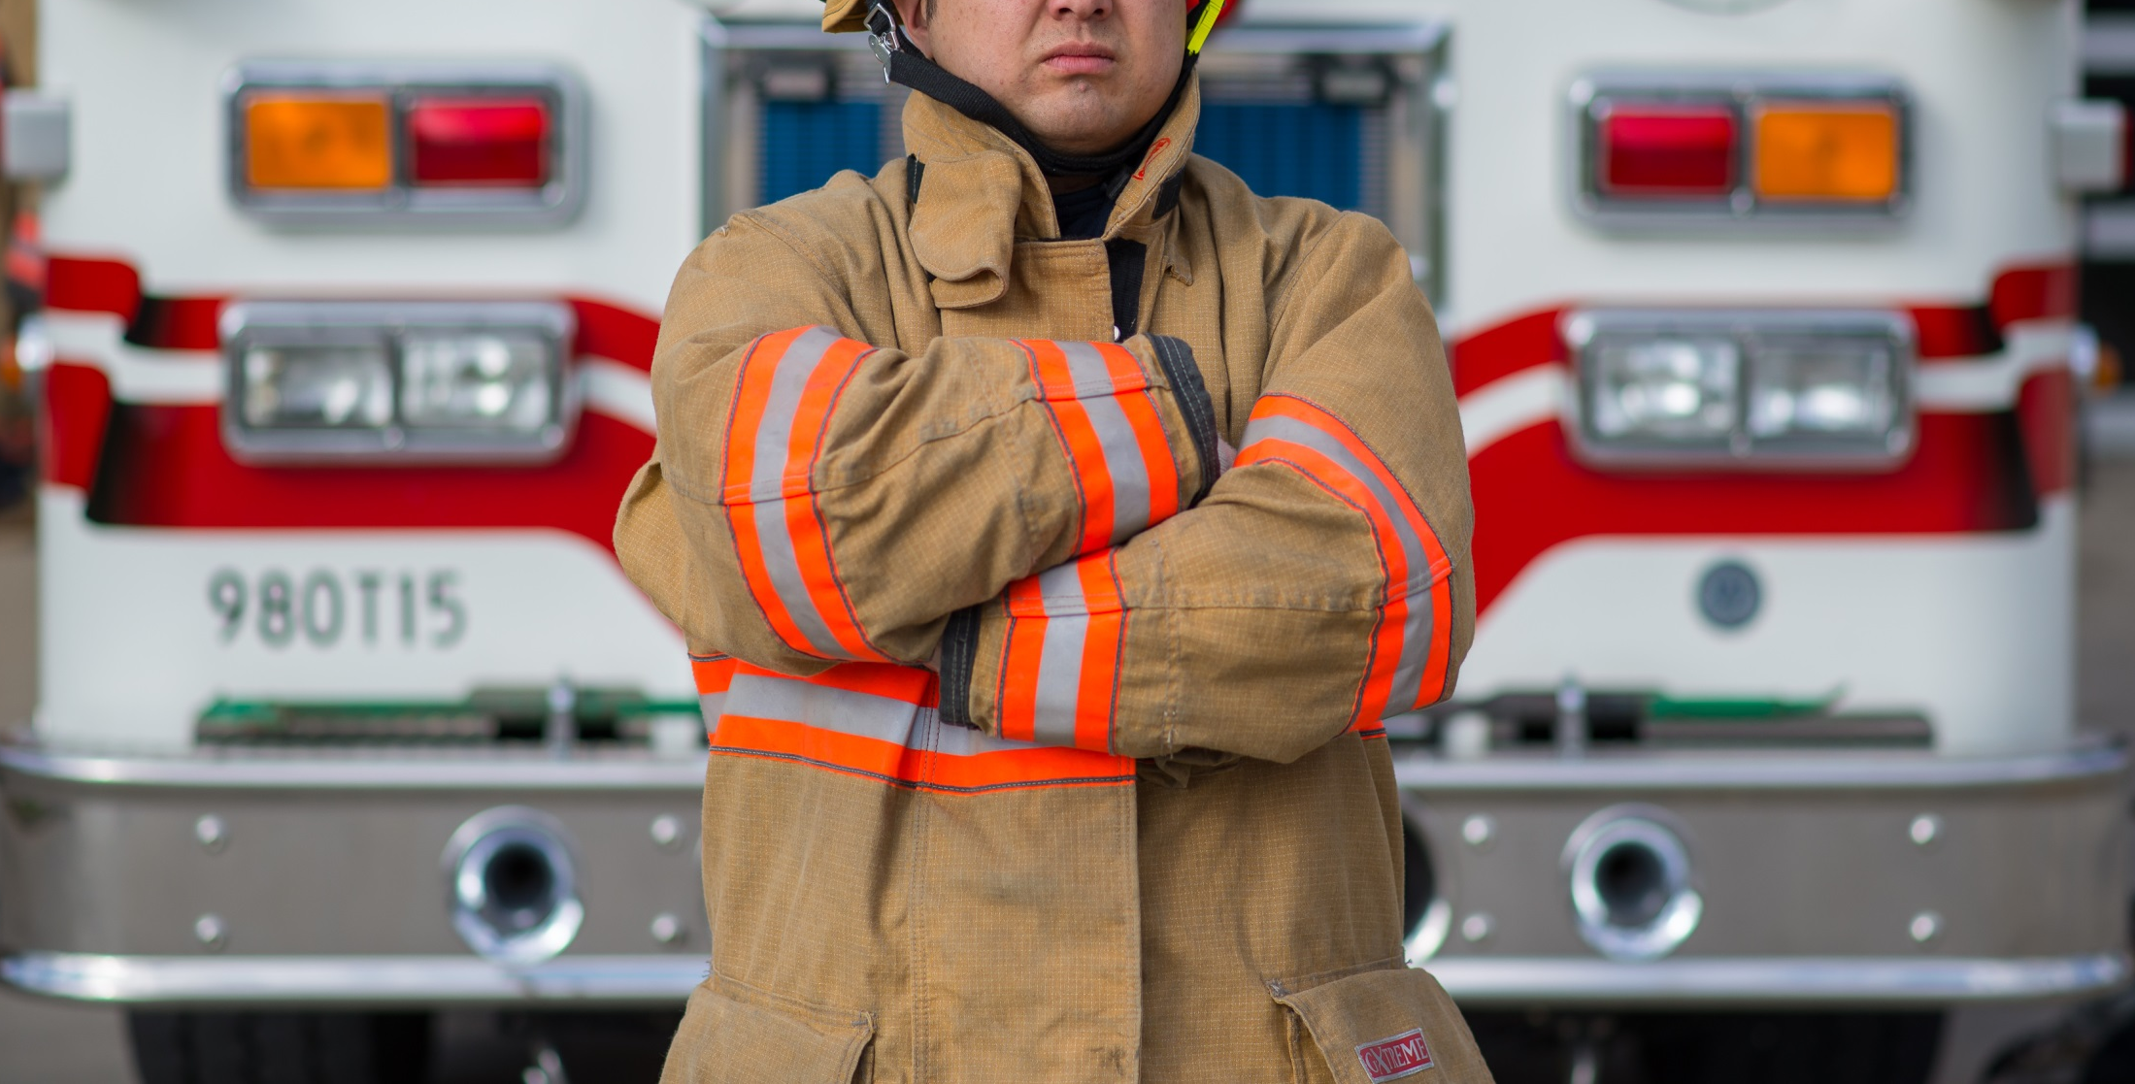
Financial Savings to the Town of (Insert Name)
by the (Insert Name) Fire Department
Your Logo Here
Notes:
Add your logo, adjust the title, and swap the photo for one from your department if you’d like.

Slide 2
Your Logo Here
Chief
(name)
Deputy Chief
(name)
Assistant Chief
(name)
Notes:
Leadership

Slide 3
Your Logo Here
We offer vital services to the community.
Notes:
List and briefly describe the services you offer, which might include the following:
Engine Company Operations
Ladder Company Operations
Rescue Company Operations
Hazardous Materials Operations
Storm Management Services
Emergency Medical Services
Fire & Injury Prevention Education
Fire Inspections
Community Social Activities

Slide 4
Your Logo Here
Adequate resources are required to protect
x people in x square miles.
Notes:
Fill in with your numbers.
Area Protected (square miles) 25
Population Protected 100,000
Number of Stations 4
ISO Fireflow 3500
ISO Classification 5
Apparatus
Engines 8
Aerial Trucks 4
Tankers 1
Rescue Trucks 2
Utility Vehicles 2
Brush Trucks -
Ambulances 6

Slide 5
Your Logo Here
Last year, we accomplished numerous goals including (insert biggest accomplishments here).
Notes:
Describe your department’s top accomplishments LAST year.

Slide 6
Your Logo Here
This year, we added to our accomplishments with (insert biggest accomplishments here).
Notes:
Describe your department’s top accomplishments THIS year.

Slide 7
Your Logo Here
Operating Expense
Total Career Cost
Capital Equipment Expense
Total Company Value
Notes:
Explain the formula and give examples.
Be sure to note that the operating expense and career cost are annual, recurring expenses.

Slide 8
Your Logo Here
(Your Operating Expense )
(Your Total Career Cost)
(Your Capital Equipment Expense)
(Result of adding above values)
Total Company Value
Notes:
Insert your numbers!

Slide 9
Your Logo Here
Our volunteers save us $(operation expense plus career cost) every year!
Notes:
Insert your number!

Slide 10
Your Logo Here
Savings per residence
$xxx
Savings per firefighter
$xxxxx
Notes:
Insert your numbers!

Slide 11
Your Logo Here
Notes:
Insert YOUR numbers! (Left click on the chart and click “Edit Data…” and a new window will open in Excel. Change the numbers and/or years in Excel and it will change on this powerpoint.)
This chart shows the costs for each year.

Slide 12
Your Logo Here
Notes:
Insert YOUR numbers! (Left click on the chart and click “Edit Data…” and a new window will open in Excel. Change the numbers and/or years in Excel and it will change on this powerpoint.)
This chart shows the number of emergency responses for each year.

Slide 13
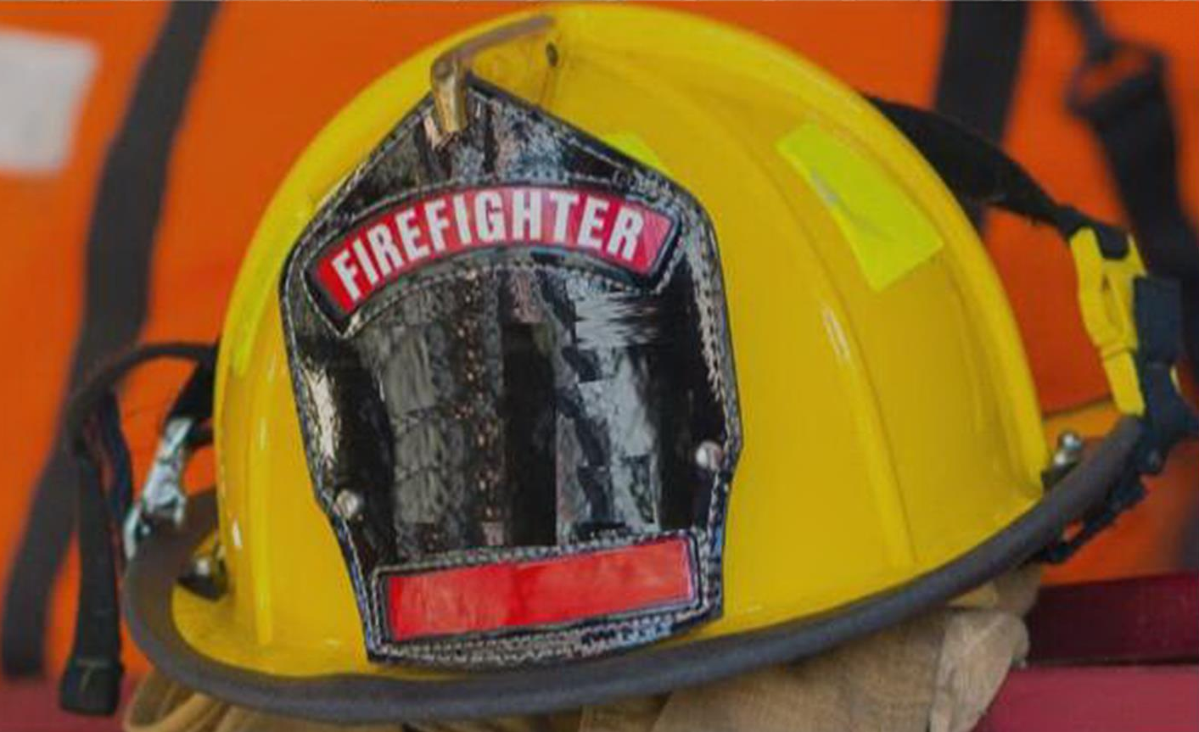
Your Logo Here
70%
VOLUNTEERS
Nationally…
Notes:
The National Volunteer Fire Council (NVFC) is the leading nonprofit membership association representing the interests of the volunteer fire, EMS, and rescue services. Organized in 1976, the NVFC serves as the voice of the volunteer fire and emergency services in the national arena and provides invaluable resources, programs, education, and advocacy for first responders across the nation. The NVFC reports that 70% of firefighters are volunteer.

Slide 14
Your Logo Here
80%
VOLUNTEERS
Nationally…
Notes:
80% of departments are mostly or all volunteer

Slide 15
Your Logo Here
$20k
TRAINING
Nationally…
Notes:
Average cost to train and equip a firefighter can exceed $20,000

Slide 16
Your Logo Here
2x
CALLS
Nationally…
Nationally…
Notes:
Number of calls nationally more than doubled in 20 years (from roughly 16 million calls in 1995 to 33.6 million in 2015)

Slide 17
Questions?
Your Logo Here

