Slide 1
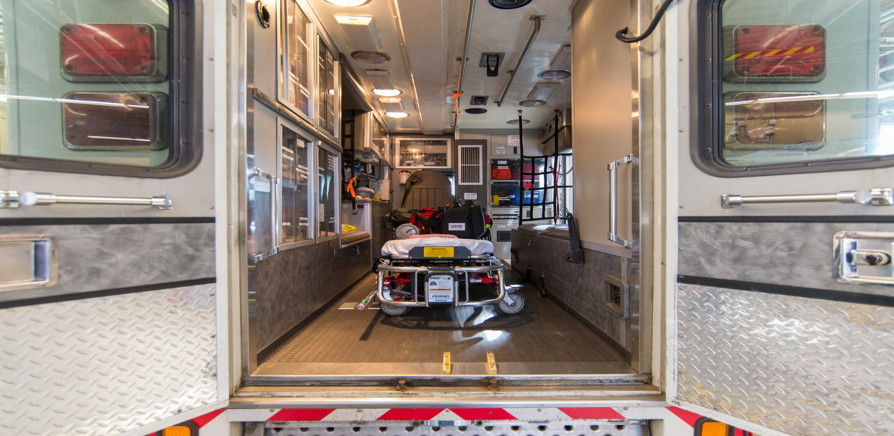
Financial Savings to the Town of (Insert Name)
by the (Insert Name) Emergency Medical Services
Your Logo Here
Notes:
Update the title and add your logo.

Slide 2
Your Logo Here
Chief
(name)
Deputy Chief
(name)
Assistant Chief
(name)
Notes:
Leadership

Slide 3
Your Logo Here
We offer vital services to the community.
Notes:
List and briefly describe the services you offer, which might include the following:
Basic Life Support
Advanced Life Support
EMS Transport
Injury Prevention Education
Community Social Activities
Fire Department Support

Slide 4
Your Logo Here
Adequate resources are required to cover
x people in x square miles.
Notes:
Area Covered (square miles) 25
Population Covered 100,000
Number of Stations 4
Licenses and Certifications: xyz
Apparatus
Ambulances 6
Mobile Paramedic Units 1
Transport Units 1

Slide 5
Your Logo Here
Last year, we accomplished numerous goals including (insert biggest accomplishments here).
Notes:
Describe your organization’s top accomplishments LAST year.

Slide 6
Your Logo Here
This year, we added to our accomplishments with (insert biggest accomplishments here).
Notes:
Describe your organization’s top accomplishments THIS year.

Slide 7
Your Logo Here
Operating Expense
Total Career Cost
Capital Equipment Expense
Total Company Value
Notes:
Explain the formula and give examples.
Be sure to note that the operating expense and career cost are annual, recurring expenses.

Slide 8
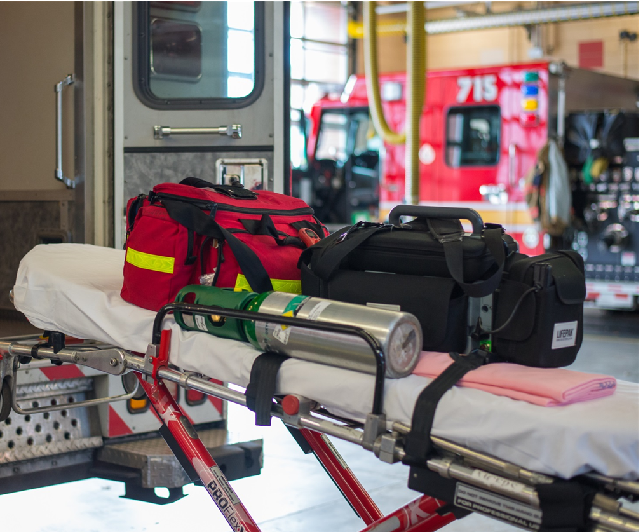
Your Logo Here
(Your Operating Expense )
(Your Total Career Cost)
(Your Capital Equipment Expense)
(Result of adding above values)
Total Company Value
Notes:
Insert your numbers!

Slide 9
Your Logo Here
Our volunteers save us $(operation expense plus career cost) every year!
Notes:
Insert your number!

Slide 10
Your Logo Here
Savings per residence
$xxx
Savings per emergency medical responder
$xxxxx
Notes:
Insert your numbers!

Slide 11
Your Logo Here
Notes:
Insert YOUR numbers! (Left click on the chart and click “Edit Data…” and a new window will open in Excel. Change the numbers and/or years in Excel and it will change on this powerpoint.)
This chart shows the costs for each year.

Slide 12
Your Logo Here
Notes:
Insert YOUR numbers! (Left click on the chart and click “Edit Data…” and a new window will open in Excel. Change the numbers and/or years in Excel and it will change on this powerpoint.)
This chart shows the number of emergency responses for each year.

Slide 13
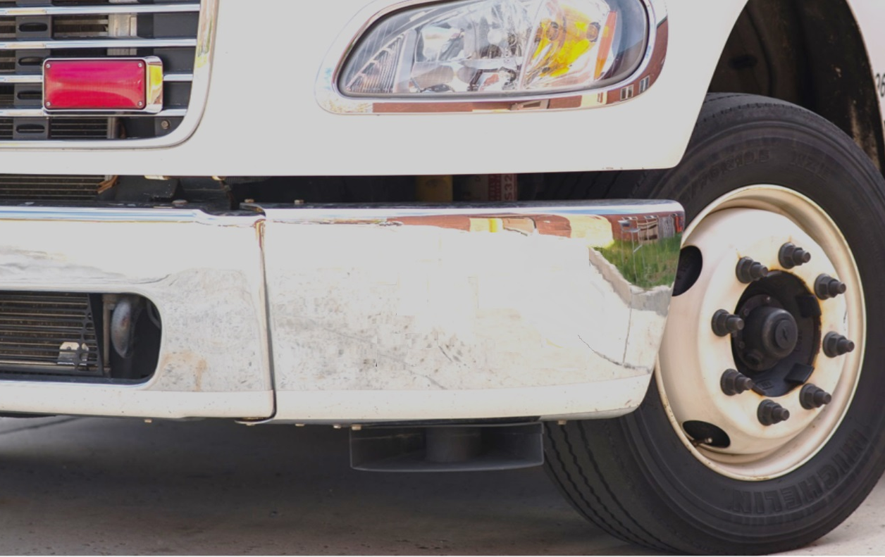
Your Logo Here
Nationwide
2X
Notes:
The National Volunteer Fire Council (NVFC) is the leading nonprofit membership association representing the interests of the volunteer fire, EMS, and rescue services. Organized in 1976, the NVFC serves as the voice of the volunteer fire and emergency services in the national arena and provides invaluable resources, programs, education, and advocacy for first responders across the nation. The NVFC reports that the number of calls nationally for fire departments more than doubled in 20 years (from roughly 16 million calls in 1995 to 33.6 million in 2015), due in large part to an increase in emergency medical calls.

Slide 14
Your Logo Here
Nationwide
150
Notes:
No matter the location, emergency medical equipment is very expensive. A single ambulance can range from $80,000 to $150,000.

Slide 15
Your Logo Here
Nationwide
30
Notes:
Advanced life support medical equipment can be anywhere from $10-30,000.

Slide 16
Questions?
Your Logo Here
Notes:
Add your logo!

